Slide 1
Engaging and Developing High Potentials Throughout Their Careers: From the Classroom to the Boardroom
Deidra Schleicher, Ph.D., Associate Professor, Purdue University
Sarah Brock, Ph.D., Director of Assessment, PDI Ninth House
Notes:
Copyright © 2010 Personnel Decisions International Corporation, d.b.a. PDI Ninth House. All Rights Reserved.
1
1

Slide 2
Objectives
Examine tools and frameworks, and gain new insights into how to:
Accurately identify high potentials
Accelerate high-potential development
Enhance your organization's ability to engage and retain high potentials
Introduce Krannert’s new approach to high potential development for Professional Masters students
And your potential involvement!
Notes:
2
1 minutes

Slide 3
“Of all the decisions an executive makes, none is as important as the decisions about people, because they determine the performance capacity of the organization.”
– Peter Drucker
Notes:
1 minute
OPTIONAL
Ask: Do You think that people truly determine the performance capacity of an organization? What practical examples have you seen that might support this statement?
Other references:
Think of Intel’s recent commercial blitz where “our rock-stars are not your rock stars” features technology leaders with large fan followings.
Ram Charan (author of Execution and prominent investor in GOOGLE) lists “Bad hiring decisions” at the top of his list of the most fatal mistakes in Ram’s “book of mistakes”.
Take my 20 best people, and virtually overnight, Microsoft becomes a mediocre company." This quote from company Chairman Bill Gates

Slide 4
Differentiating Performance and Potential
Rating of Performance
HiPo:
Assess; Coach or move
HiPo:
Stretch; Plan next step
High Flyer: Prepare for next role
High
Low Performer: Address fit
Performer: Engage and develop
Achiever: Stretch in role or develop for next
Some
Assessment of
Leadership Potential
At Risk: Address performance
Solid Performer: Reinforce and engage
High Achiever: Reward and engage
At
potential
Not meeting
expectations
Meets
expectations
Exceeds
expectations
Notes:
1 min. – this is just a point of connection, not a lesson.
“most of you are using something like this; it’s important to really try to get managers to differentiate Performance vs. Potential.”
High potential: Capable of advancing two levels or taking on significantly larger and more complex assignments.
Some potential: Capable of advancing one level or performing well in somewhat larger or more complex role.
At potential: Likely to grow to some extent at current level.
We need to be very specific about the kind of potential we are talking about in any definition. We are specifically talking about leadership potential, not all the other very valuable kinds potential people bring to their work. People continue to grow and add increasing value to their organizations in many ways other than taking on bigger and bigger leadership roles. Short-handing the terminology to just call it "potential" is misleading and narrow-minded.

Slide 5
Why Do We Need a New Approach to High Potentials?
Critical organizational need
56% of organizations report a significant shortage of leaders to fill key positions⁷
31% more predict a shortage in the next few years⁷
46% have no systemic process to identify and develop candidates for key leadership positions⁸
Notes:
Less than 1 min.
87% are reporting some leadership shortage…..cumulative

Slide 6
Why Do We Need a New Approach to High Potentials?
The current approach is not working for organizations . . .
15%
Only 15% are satisfied with their high-potential practices¹
40%
Up to 40% of high-potential promotions end in failure²
Notes:
Less than 1 min.
NOTE: Sources for the various statistics are listed at the end of the slides.

Slide 7
Why Do We Need a New Approach to High Potentials?
. . . Or for high potentials
25%
At risk of derailment³
25%
Intend to leave their company within a year²
40%
Do not trust senior management²
30%
Feel disengaged and do not put in their full effort at work²
Notes:
1 min.

Slide 8
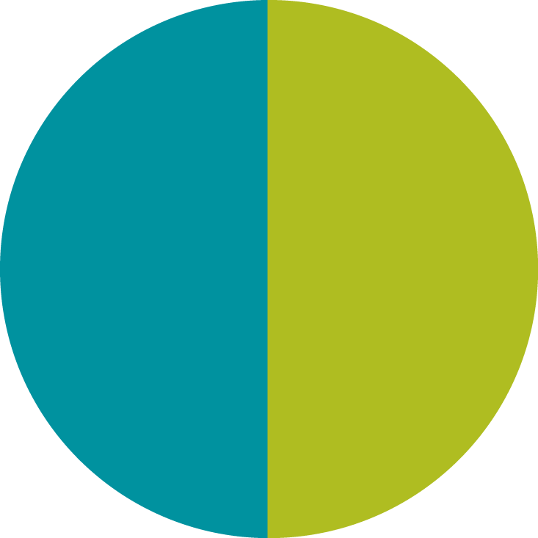
High-Potential Experience Cycle™
Organization’s
Process
Forecast talent needs and requirements
Accurately identify and engage high potentials
Accelerate development for high potentials
Manage transitions into new roles
Address governance, communication, and evaluation
High-Potential
Leader’s Experience
Assess and plan for the future
Commit and engage
Develop and learn
Transition and perform in new role
Manage work and non-work priorities
High-Potential Experience Cycle™
1 Plan
2 Identify
Organization’s High-Potential Process
High-Potential Leader’s Experience
3 Develop
4 Transition
5 Manage
Notes:
4 min. or longer if they have questions at this point. Make sure they get it.
Parallel activities
Two key points for building engagement, retention, lasting value.
Leaders are going through their own parallel experience cycle. So how can organizations understand their needs and help them through that process?
Leaders are going through the experience of whatever the organization is doing. When organizations are doing stuff to their high potentials, like evaluating or developing or transitioning them into new roles or communicating with them, the high potentials are experiencing something. They interpret that experience and draw conclusions about how the organization values them and whether they find the experience useful. Does the organization’s process treat HPL’s with respect, consideration, take their needs and reactions and perceptions into account, etc.
Doing a great job on the organization’s process is not enough
In fact, programs often fail to achieve desired outcomes because of:
Too much focus on optimizing the technical process
Too little focus on the leader’s personal experience:
Are they engaged?
Do they find meaning and value in the experience?
Do they feel valued?
Engagement, retention, higher performance, faster learning, and accelerated readiness result directly from:
Understanding and meeting the needs of high potentials themselves
AND designing the program to accomplish organizational objectives.

Slide 9
Step 1: Plan for the Future
Forecast Talent Needs
and Requirements
Identify leadership roles and positions to be targeted
Define purpose, priorities, challenges, needs, and requirements for each role
Define time frames: When do you need them?
Consider the supply: Hire or develop?
Assess and Plan
for the Future
Clarify goals, values, and where you want to go
Assess capabilities and development needs
Assess career options and opportunities
Notes:
2-3 minute. Lots of data on this slide and others. Pretty straightforward.
What does the organization need to do?
What does the leader need to do?
Clarify goals and values
What is most important and meaningful to me at work?
What are my short-term and long-term career goals?
What matters to me outside of work?
Assess capabilities and development needs
What are my key strengths and how can I best deploy them?
What are my key weaknesses and how can I best mitigate them?
Assess opportunities
Where can I find or create the best opportunities to achieve my goals?
What do I need to do to be successful in this organization?
3. How do they need to do it?
Key Point: A key to engagement is to give leaders tools and information they need to understand themselves, career path, organizational options. Think about the loyalty you can instill in all leaders, not just Hi-Po’s, by helping them think through their careers and goals and demonstrating that you care about them as people.

Slide 10
Step 2: Identifying High Potentials: How Difficult Is This?
“Many measures of potential are worse than chance”⁴
At most, 30 percent of high performers are likely to be high potentials²
For people with two bosses, their bosses disagree more than half the time over the person’s potential to advance⁵
Notes:
1 min.
Really difficult to do this well. This is one of the reasons 40% of promotions end in failure. We don’t pick the right people….

Slide 11
Step 2: Identify High Potentials
Accurately Identify and
Engage High Potentials
Define required attributes of high-potential leaders
Identify high-potential candidates
Inform and engage
Align with HR systems (e.g., succession, selection/ promotion)
Commit and Engage
Understand what it means
Evaluate priorities
Commit to invest time and energy
Maintain humility and perspective
Notes:
2-3 min.
Two Key Points
Org side: Can look very secretive, biased, exclusive. Can be handled in way that communicates clearly what is valued and how to participate or can perpetuate sense of entitlement and exclusion.
Define required attributes of high potential leaders
In general
For our organization
For specific roles and positions
Identify
Structured talent reviews
Nominate, screen, and assess
Inform and engage
Clarify communication strategy and steps
Communicate expectations, requirements, and commitments
Align with HR systems
Succession plans
2. Leader side: Help them think through what it means and what is required – organizaitonal commitment and expectations / personal time and energy required. Evaluate pros and cons for them and take the decision seriously.

Slide 12
Step 3: Develop and Prepare for Future Roles
Accelerate Development
for High Potentials
Drive individual development
Drive systemic development processes
Reinforce a learning culture
Develop and Learn
Prepare development plans
Learn strategies and skills for self-directed development
Adopt attitude of learning
Engage in development activities and on-the-job learning
Monitor and measure progress
Notes:
“we could have an all-day workshop just on this topic…”
2-3 min.
1. Drive individual development
Clarify development goals and objectives with individual leaders
Craft short-term and long-term development plans
Monitor and provide regular feedback on progress
Clarify changing needs and expectations
Review and update development plans
Hold leaders and their managers accountable for progress
2. Drive systemic development processes
Design development programs and experiences tailored to strategic needs and to leaders’ goals, values, and development needs
Orchestrate short-term and long-term development activities
Tactical development programs, projects and tasks
Job assignments, rotations, and key experiences
3. Reinforce a learning culture
Equip everyone to be self-directed learners
Support, recognize, and reward leaders who develop and share talent
Support leaders who experiment, take risks, and accept stretch assignments
Key Point:
-- Teach people how to learn.
Prepare development plans
Craft short-term and long-term development plans
Learn strategies and skills for self-directed development
Seeking feedback
Reflection
Adopt attitude of learning
Cultivate curiosity
Make development a habit
Engage in development activities
Allocate investment in current performance vs. future performance
Monitor and measure progress: Accountability

Slide 13
Over 25% 0f High Potentials at Risk of Derailment^{3,9}
Smart, driven, ambitious, push hard to get things done
Never learn to delegate and work through others
Brilliant ideas, quick to reach conclusions
Assume they are right and appear arrogant
Never learn to influence, compromise, collaborate, enlist others
Advance rapidly and don’t learn the lessons at each level that others do
Others eventually derail because they were misidentified
High performing, likeable leaders who avoid conflict
Smart, creative individual contributors
Notes:
2 min.
The trap of high-potential development
Highly motivated to perform and often seem eager to learn, but in some ways they are the most impervious learners
Micromanagers
Key Point:
Good learners in many ways, impervious to learning in many ways.
Self-confident.

Slide 14
How D0 You Accelerate Development for High Potentials?
PDI Development Pipeline® Necessary Conditions for Learning
INSIGHT
MOTIVATION
CAPABILITIES
REAL-WORLD PRACTICE
ACCOUNTABILITY
Do they know what they need to develop?
Are they willing to invest the time and energy it takes?
Do they have the skills and knowledge required for success?
Do they take advantage of opportunities to use their skills where it matters?
Do they feel accountable to use their capabilities to improve performance and results?
Notes:
2 min.
Many in the audience will know this, but even if they don’t, this is just a quick overview, not a major focal point.

Slide 15
Reasons High Potentials May Not Be Good Learners . . .
Insight
Smart, self-confident; may dismiss feedback
Most feedback is positive; may not get well-rounded perspective
Actual negatives may be avoided to avoid demotivating
Motivation
Intense task focus; channel energy into achieving (not learning)
Willing to work long hours to achieve
Capabilities
Advance rapidly; may not learn all the lessons that others do
Action-oriented; rarely reflect on what works and what doesn’t
Real-world Practice
Move so fast they miss opportunities
Accountability
They get promoted anyway
Notes:
2 min. Don’t speak to every bullet, just the ones you think are worthwhile.
While they have high motivation and are highly action-oriented, they may have little tolerance for reflection…. Don’t want to look in the rear view mirror.
Motivation to perform, vs. motivation to develop
Insight: believe in themselves and may ignore feedback.
They succeed on basis of raw horsepower and longer hours.
Key Point: Can’t just throw them in, expect them to learn all the right lessons without support, teaching them how to learn. Provide coaching, mentoring, feedback tailored to their needs, help them along the way. Meet them where they are.

Slide 16
High Potentials Need a Different Approach to Maximize Learning
Holistic, whole-person development
Long-term, future focus
Visibility
Relationships and networking
Learning to Learn
Versatility
Challenge and Stretch
Feedback-Rich
Holistic, whole-person development
Long-term, future focus
Visibility
Relationships and networking
Learning-to-learn
Versatility
Challenge and stretch
Feedback rich
Notes:
3 minutes. Emphasize that this is based on the kinds of ways that Hi-Po’s are measurably different in skills, values, interests, needs. Strong focus on importance of coaches
1. Holistic, whole-person development
Knowing: Knowledge, insight, principles
Doing: Skills, capabilities
Being: Leadership identity, character, values, mission, maturity
* I mention the importance of instilling values and integrity and a sense of identity as a leader throughout this workshop.
2. Long-term, future focus
Both short-term and long-term development plans. Career plan. Preparing for future needs.
3. Visibility
Higher pressure and scrutiny
4. Relationships and networking
Create a community of learning
Enhance engagement and build alliances
5. Learning-to-learn: Extract maximum learning from every experience
Curiosity and attitude of learning
Self-awareness
Reflection
Seeking feedback
6. Versatility
Exposure to wide range of challenges and experiences
7. Challenge and stretch
Developmental roles, tasks, projects they’re not ready for
8. Feedback-rich
Multiple sources: 360, personality/values, simulations, etc.
Coaches are critical to this process!
Key Point:
Some of these are related to the nature of high potentials themselves: they value visibility, challenge, relationships.
Some are related to nature of their role: future focus, versatility.
Holistic, whole-person development
Knowing: Knowledge, insight, principles
Doing: Skills, capabilities
Being
Leadership identity
Character, integrity, maturity
Values, mission
Long-term, future focus
Both short-term and long-term development plans
Visibility
Higher pressure and scrutiny
Relationships and networking
Create a community of learning
Enhance engagement and build alliances
Learning-to-learn: Extract maximum learning from every experience
Curiosity and attitude of learning
Self-awareness
Reflection
Seeking feedback
Versatility
Exposure to wide range of challenges and experiences
Challenge and stretch
Developmental roles, tasks, projects they’re not ready for
Feedback-rich
Multiple sources: 360, personality/values, simulations, etc

Slide 17
Provide Four Types of Valuable Learning Experiences
Notes:
2 minutes
How do you think about the kinds of experiences people need? They love challenge, so give them these.
How do they learn from experience? They are not the most reflective people. How do you teach them how to learn from their experiences?
Teach them to be curious, reflective, etc. so that they really learn.

Slide 18
Step 4: Transition into New Roles: Major Risks
Transitions are danger zones
40% of high-potential promotions fail²
Why?
Never learned how to manage transition process
Peter Principle; high performers who have been misidentified
Lack of support for big stretch assignments
Lack of clarity around expectations
Radically different success factors in new role
Notes:
1 min.
Especially senior level, even higher likelihood of failure.
External hires also fail.
Why is the difficult even more true for high potentials? Why do even greater numbers of high potentials fail?
Transitions come fast and furious.
The good ones tend to build the capacity to transition well.
I was a big fish in a small pond, now I’m a small fish again.

Slide 19
Step 4: Transition into New Roles
Manage Transitions
into New Roles
Assess readiness and fit for relevant roles
Select based on fit and opportunity for continued development
Support transitions
Reset expectations for the leader
Maintain focus on engaging and meeting the broader needs of the leader
Transition and Perform
In New Role
Evaluate offer and decide whether to accept position
Clarify expectations, priorities, and objectives for the role
Manage your Five Agendas as a leader
Business agenda
Leadership agenda
Relationship agenda
Personal agenda
Learning agenda
Notes:
3 minutes.
Key Point:
Organization: Pre-decision focus. 90% of the organization’s time and energy happens before the move is made.
Leader: Post-decision. 90% of the leader’s energy and focus occurs after the move. Don’t abandon people.
This is another huge opportunity to ensure engagement. Support people, show them you care. Stay in touch. – POWER OF COACH FOR FIRST () DAYS!
Don’t abandon them after the move.
Discuss what this means. Are they still a high potential? Do they start over in the process?
Clear expectations: Is this primarily a test? Learning opportunity? What do you want them to learn in this role? Is this a critical role you want them to be successful in? Problem to fix?
Five agendas……
This is a tool that’s useful for leadership development at many points, but especially a useful tool in transitions.
Valuable time to reflect on who you want to be as a leader. What do you stand for, etc.
What values do you want to be known for? How do you want your new team to see you? What values do you want the team to operate with?

Slide 20
Step 5: Manage the Broader Context
Address Governance,
Communication, and Evaluation
Set up management system and programs
Clarify policies and practices
Create and implement a communication plan
Ensure management support and alignment
Define employee “brand” and value proposition and how they apply to high-potential leaders
Evaluate impact and effectiveness
Manage Work and
Non-work Priorities
Develop an authentic, holistic vision for yourself and your life
Make appropriate choices to integrate work and non-work priorities
Family
Health and fitness
Financial
Community and social life
Recreation and leisure
Spiritual
Notes:
2 min.
Start to think about something to make sure this ends on a strong note!
Key Point: One more opportunity for the organization to really engage leaders, by helping and supporting them with their broader life and priorities.

Slide 21
Where Will You Take Action?
High-Potential Experience Cycle™
High-Potential
Leader’s Experience
Assess and plan for the future
Commit and engage
Develop and learn
Transition and perform in new role
Manage work and non-work priorities
Organization’s Process
Forecast talent needs and requirements
Accurately identify and engage high potentials
Accelerate development for high potentials
Manage transitions into new roles
Address governance, communication, and evaluation
High-Potential Experience Cycle™
1 Plan
2 Identify
Organization’s High-Potential Process
High-Potential Leader’s Experience
3 Develop
4 Transition
5 Manage
Notes:
What does the High-Potential Experience Cycle look like in your organization?
Which steps are most challenging for your organization?
What’s not working?
Where are leaders not fully engaged?
What is the impact?
Provocative, action-oriented question: What will you do? How will you use what you learned here to energize your organization and invigorate your HiPo program?
Most importantly, how will you make sure the HiPo Leader’s perspective and needs are addressed??

Slide 22
Where Will Krannert Take Action?
High-Potential Experience Cycle™
High-Potential
Leader’s Experience
Assess and plan for the future
Commit and engage
Develop and learn
Transition and perform in new role
Manage work and non-work priorities
Organization’s Process
Forecast talent needs and requirements
Accurately identify and engage high potentials
Accelerate development for high potentials
Manage transitions into new roles
Address governance, communication, and evaluation
High-Potential Experience Cycle™
1 Plan
2 Identify
Organization’s High-Potential Process
High-Potential Leader’s Experience
3 Develop
4 Transition
5 Manage

Slide 23
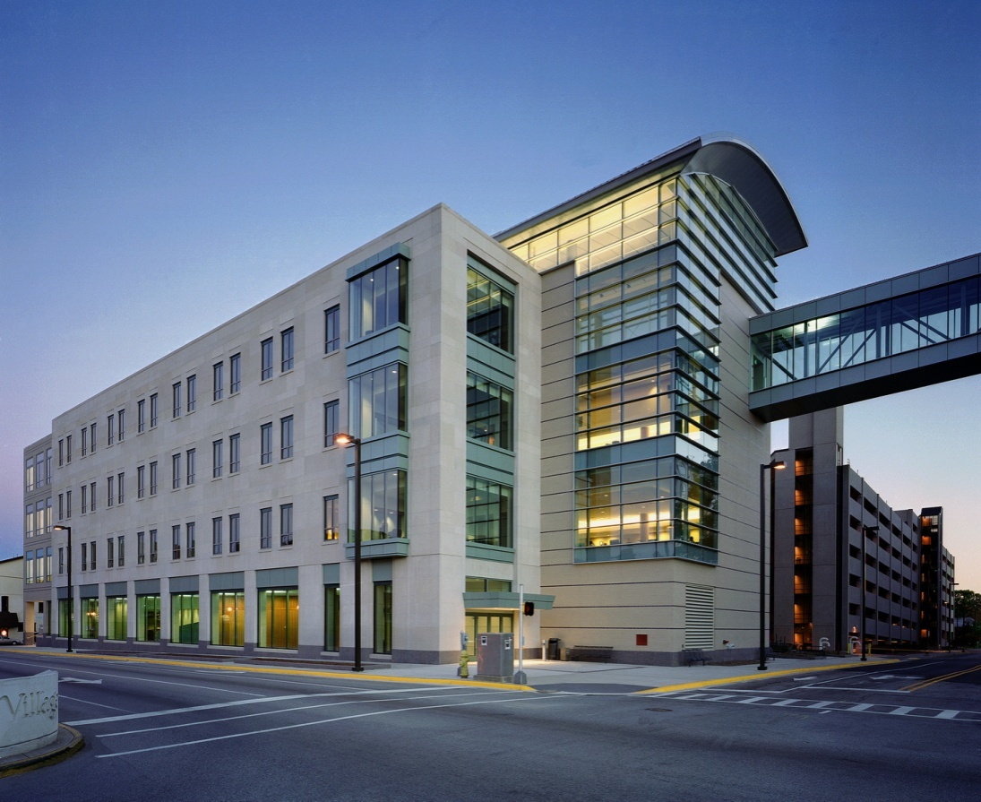
Launching Tomorrow’s Business Leaders: Engagement and Development

Slide 24
Background and Goals of the Initiative
Preparing our students to be global business leaders
Success at Krannert
Success in the (initial) job market
Long-term career success
Offering a supplement to curricular experiences
Relational and leadership capabilities: the “soft skills”?
Creating an individualized developmental plan
Instilling an appreciation for openness to feedback and a developmental orientation
Emulating the best practices of organizations in managing high potential human capital

Slide 25
What do organizations do? (Best Practices in Human Capital Management)
An integrated approach to assessment and development
Based around a “competency model” (Krannert Competencies)
Careful and comprehensive assessment on the behavioral competencies
“360” evaluations, to provide complete picture
Comprehensive feedback regarding ratings on the competencies
Provision of developmental opportunities that explicitly target specific competencies
Provision of performance coaches
To help make sense of feedback and create developmental action plans

Slide 26
Engaging Coaches
Looking for talented individuals to serve as coaches
Selection and matching of coaches to occur in November
Two month training/certification program (begins in January)
Wednesdays from 4:30 – 6:30 pm (virtual participation possible)
Will receive a Krannert-Adayana certificate in Performance Coaching
Expectation of three to four meetings (Spring semester) with each student you are coaching
Interested? Please contact Prof. Deidra Schleicher at deidra@purdue.edu

Slide 27
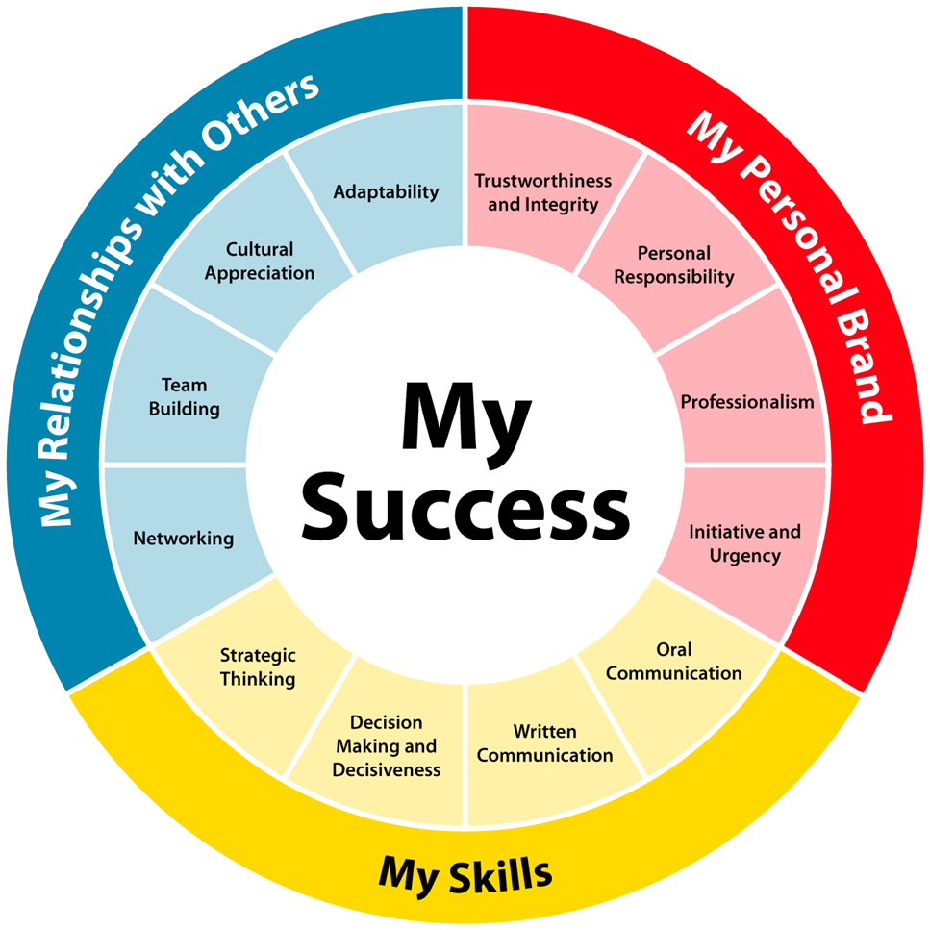
Krannert Competencies (back)

Slide 28
Sources
Conference Board (2005).
Martin, J., & Schmidt, C. (2010). How to keep your top talent. Harvard Business Review, 88(5), 54-61.
Peterson, D. B. (2008). High potential, high risk. HR Magazine, 53(3), 85-87.
Corporate Leadership Council. (2005). Realizing the full potential of rising talent. Washington, DC: Corporate Executive Board.
PDI Ninth House research.
Hewitt, Top Companies for Leaders report.
Adler, S., & Mills, A. (2008). Controlling leadership talent risk: An enterprise imperative. Ready, 1(1), 1-5.
Bernthal, P., & Wellins, R. S. (2004). Leadership Forecast: 2003-2004. Bridgeville, PA: Development Dimensions International.
Bottger, P. C., & Barsoux, J. (2010). Designated as high potential? The fast track to failure. The Conference Board Review, February, pp. 2-4.

