Slide 1
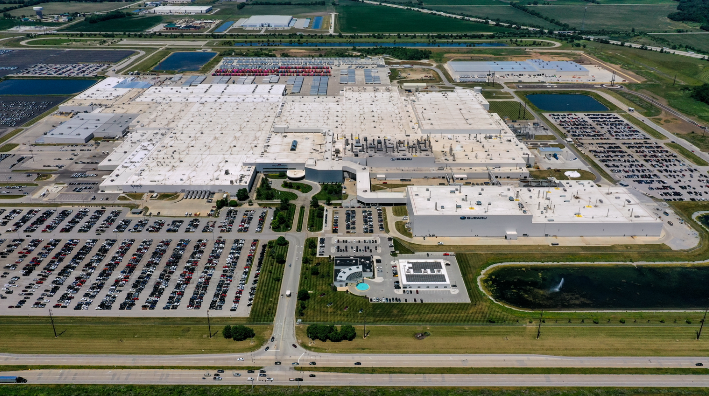
Charles “Buddy” Penquite, Jr. Sr. Manager – Supplier Management
Managing Supply Chain Disruption
February 18, 2022

Slide 2
Managing Supply Chain Disruption
Automotive 101
Vehicle Development Process
Consumer Grade –vs – Automotive Grade
Automotive Life Cycle
Parts Supply Concept
Global – Scales of Economy & Specialization
Supply & Demand Shift - Mitigation
ADAS & IIHS – Focused Issue
Semiconductors – Expansive Issue

Slide 3
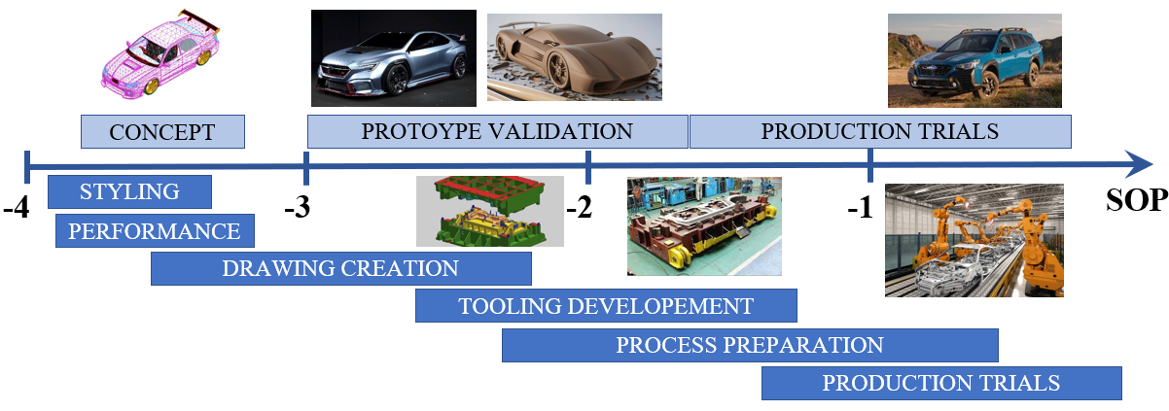
Automotive 101
Vehicle Development Process

Slide 4
Automotive 101
Consumer Grade – VS –Automotive Grade
Automotive certification takes 6-12 months to qualify components
* www.usitc.gov/publications/ Executive Briefings on trade May 2019
- VS -

Slide 5
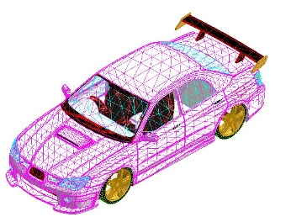
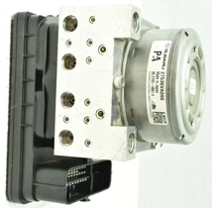
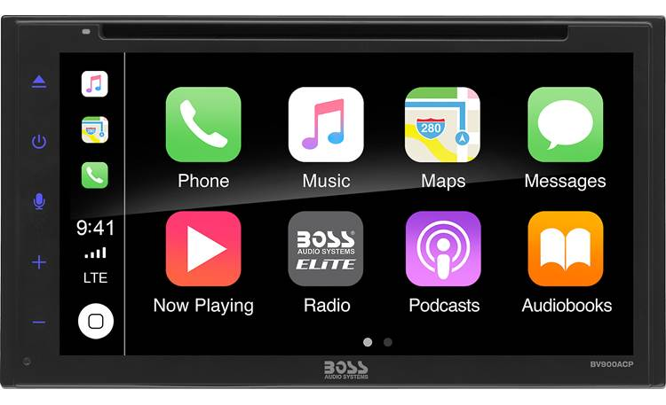
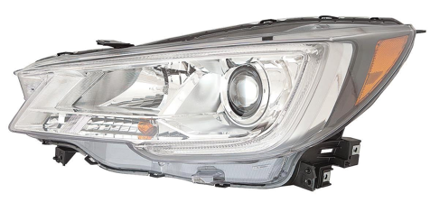
Automotive 101
Automotive Life Cycle
Development
(3-4 Years)
Mass Production
(5-6 Years)
Service-Aftermarket
(10-15 Years)

Slide 6
Parts Supply Concept
Global – Scales of Economy & Specialization
Sample of supply chain for electronic components
4 Weeks
26 Weeks

Slide 7
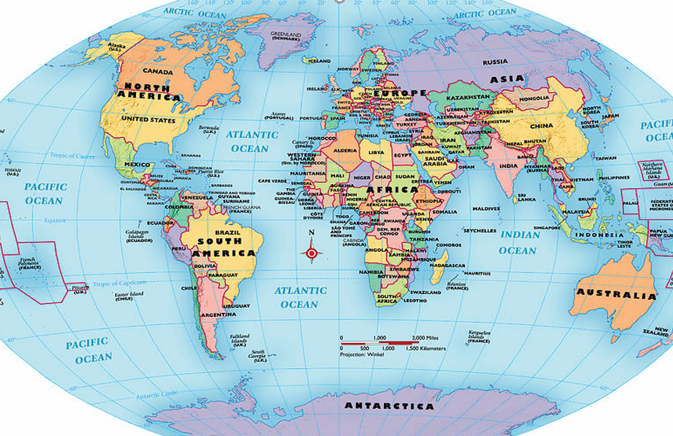
Parts Supply Concept
Brake System Hydraulic Unit

Slide 8
Parts Supply Concept
Rear Brake Sonar Sensor

Slide 9
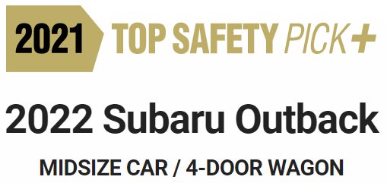
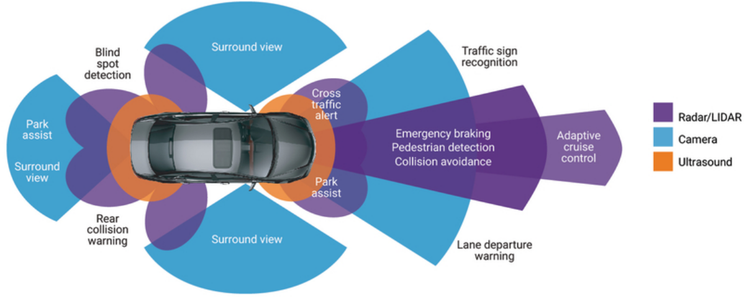
Supply & Demand Shift
Changes in the Market
ADAS Rise in the take rate
IIHS Evaluations
* www.synopsys.com

Slide 10
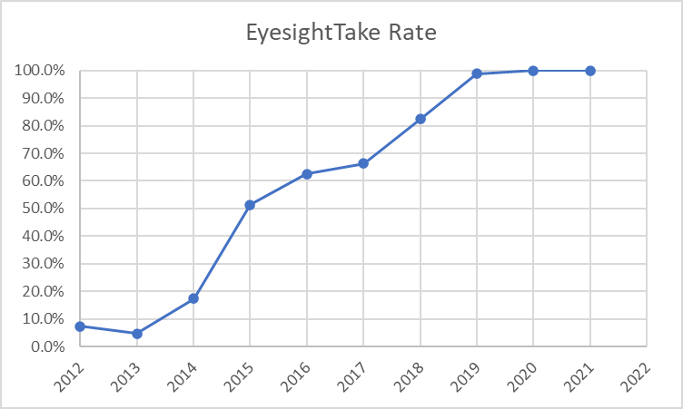
Supply & Demand Shift
Eyesight – Focused Issue
Focus for Subaru was to have top level Collision prevention system.
9 years went from 0 to 100% take rate
Full Model
Change
Full Model
Change

Slide 11
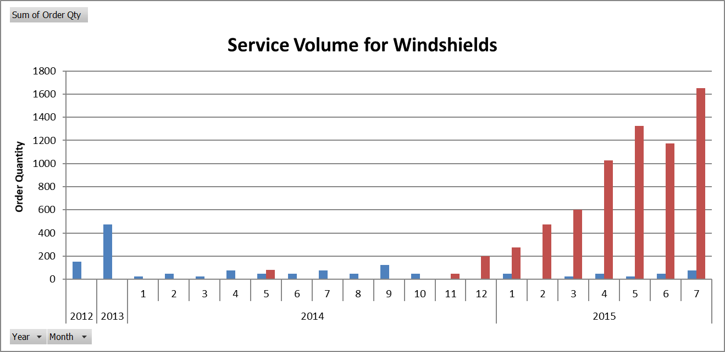
Supply & Demand Shift
Eyesight – Focused Issue
Tenfold increase service Why?

Slide 12
Supply & Demand Shift
Eyesight – Focused Issue
Cause: Due to the Eyesight system reading through the Windshield the aftermarket depends on OEM grade glass to assure Eyesight performance.
Mitigation: (12-18 month process)
-Import glass from Japan supplier approved for Eyesight.
-Work with the U.S. Supplier changes
-Outsource other OEM glass
-Move SIA non-eyesight glass to another facility
-Net increase of capacity for Eyesight

Slide 13
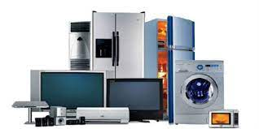
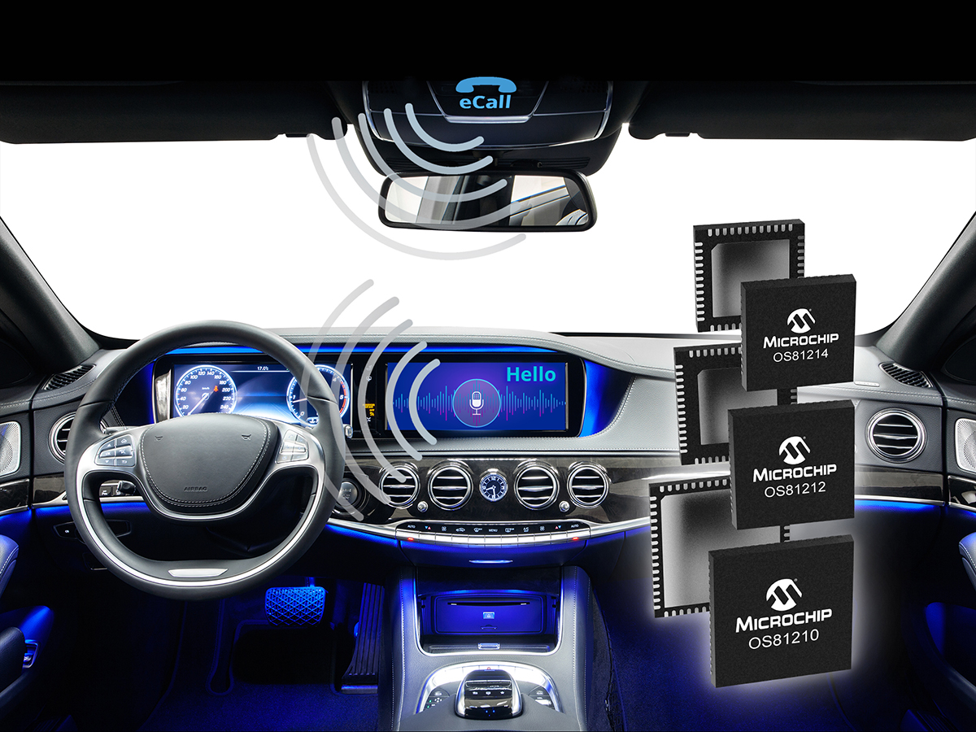
Semiconductors
4 Major Industries: Communications ~33% Computers ~28%
Automotive ~12% Consumer Electronics ~13%

Slide 14
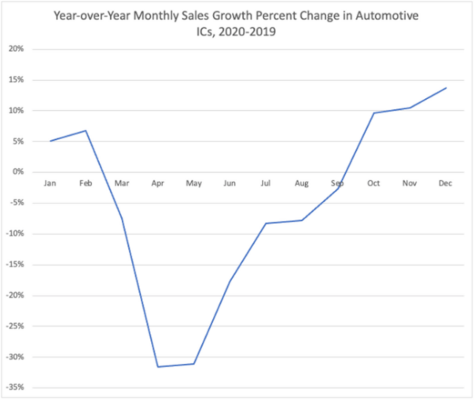
Supply & Demand Shift
Semiconductors – Expansive Issues
“You cut orders”
COVID 19 Shutdown
“You, cut orders”
“No, we didn’t”
* www.semiconductors.org/ World Semiconductor Trade Statistics Bluebook sales data, 2020-2019

Slide 15
Supply & Demand Shift
Semiconductors – Expansive Issues
Cause: COVID-19 drove swift demand shift to other industries. Remote Healthcare, Remote Work, Virtual learning, etc.
Mitigation: (12 months +)
-Swap out constrained components. “Drop in” solution.
-Secondary source for “identical” part.
-Minimize lead times – “pull in” parts earlier.
-Get strong forecasting to adjust consumption to match capability.
Keypoint:
Redesign requires minimum of 18-24 months.

Slide 16
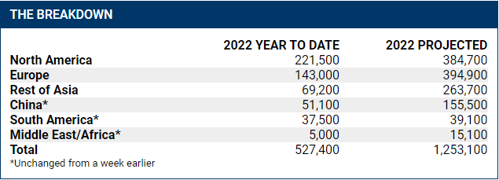
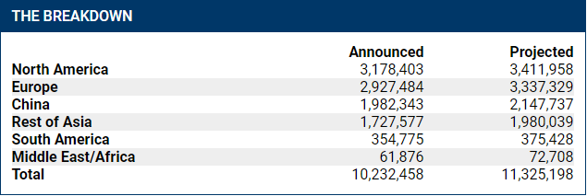
Supply & Demand Shift
* www.autonews.com/ Dated 2/14/2022 autoforecastsolutions.com.
* www.autonews.com/ Dated 12/13/2021 autoforecastsolutions.com.

Slide 17
Managing Supply Chain Disruption
Key Takeaways:
Complex supply chains need multiple sources if possible.
Supplier doesn’t want to tell you about the problem.
Look for options to eliminate the constrained parts.
Utilize information from Suppliers to validate issues at a holistic level.
Maintain collaborative environment.
Regularly meet with the supplier foster Open & Honest Communication.

