Slide 1
Managing Supply Chain in Unmanageable Circumstances
Social Media Tiles and Postings
Barry Greenhouse
SVP & President, Global Supply Chain & Customer Experience
Grainger
Purdue University Global Supply Chain Management Initiative
Managing Supply Chain Disruption Virtual Conference
Feb. 18, 2022

Slide 2
The Grainger Edge

Slide 3
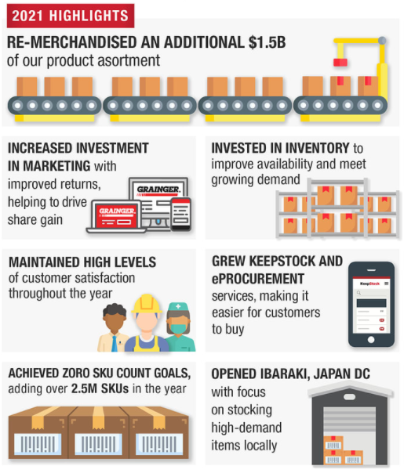
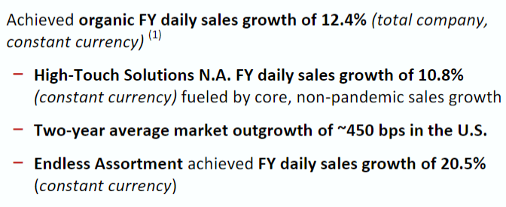
Leading broad line distributor of MRO products and services determined to Keep the World Working through innovative technology solutions and deep customer relationships⁽¹⁾
$13B
2021 sales
78%
19%
Company founded in
50 years
~23k
team members
4.5M
1927
of consecutive dividend increases
Customers worldwide
Largest
14th
30M
GWW
MRO distributor in North America
largest N.A. e-commerce retailer ⁽²⁾
products offered globally
NYSE
above figures as of 2.3.22
MRO stands for maintenance, repair and operations
Source: Digital Commerce 360 (2020 Top 500 ranking of North American online retailers)
3

Slide 4
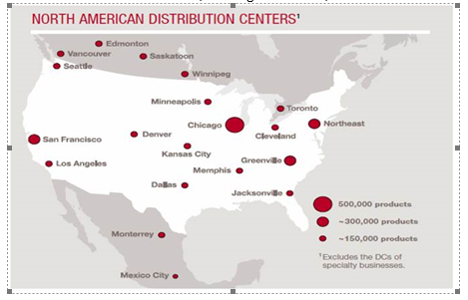
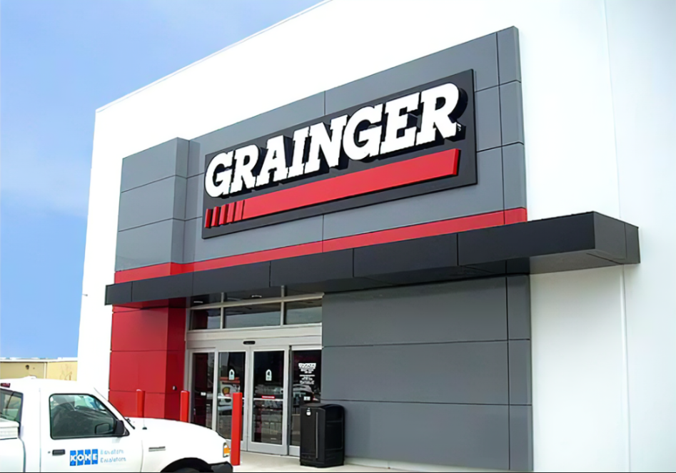
Global Supply Chain & Customer Experience
22 DCs: Canada, US, Mexico:
Distribution center (DC) operations, transportation, inventory planning, and supplier performance management for North America
Branch and customer service centers in the U.S. and Canada
Network strategy, capacity planning and management, and warehouse management systems application support
Louisville
Customer service + support:
Branch Network: 300+ locations
WE’RE ALWAYS HIRING jobs.grainger.com

Slide 5
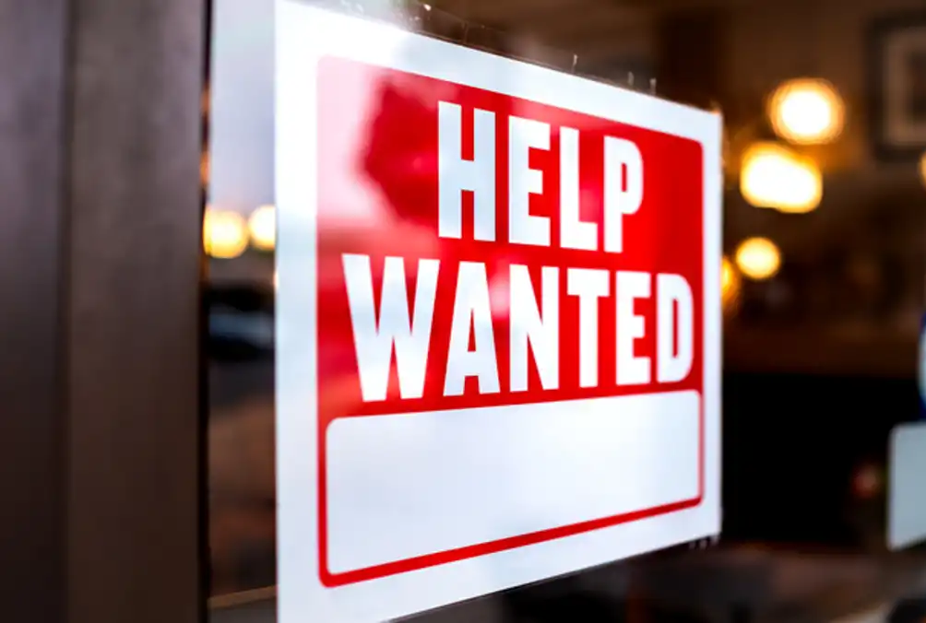
Global Supply Chain Challenges
Commodity-Driven
Product Shortages
Late Supplier
Shipments
Hiring
Challenges
Transportation
Constraints

Slide 6
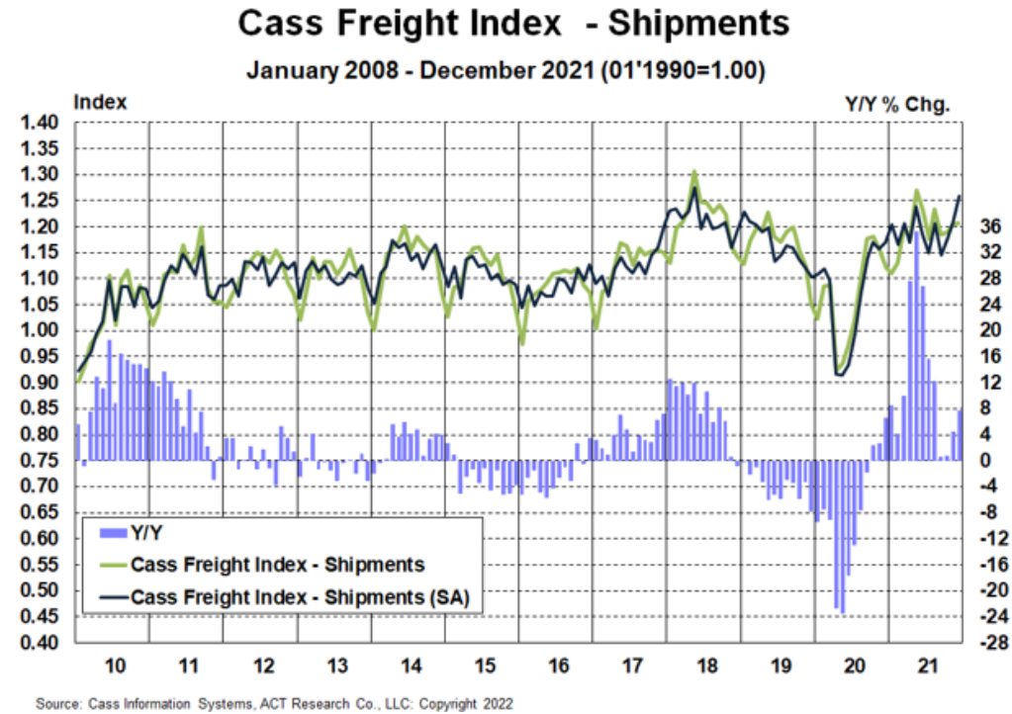
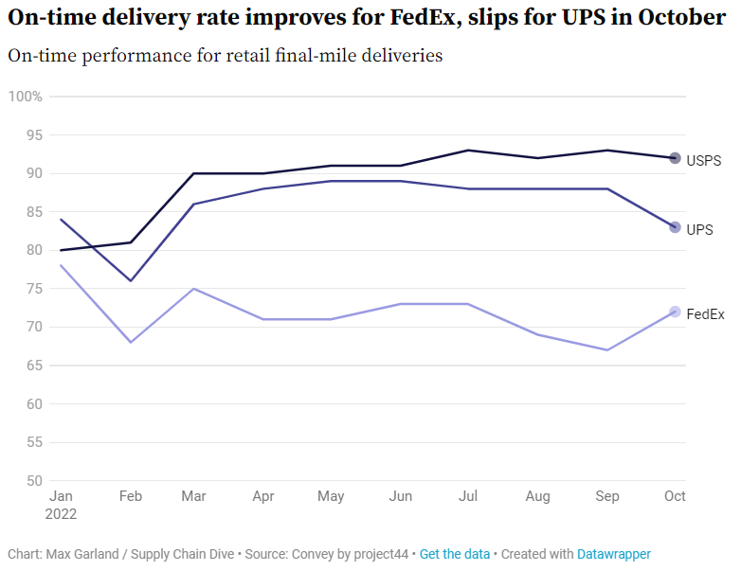
U.S. Transportation Services Constrained Across All Modes
The U.S. Transportation industry remains tight on capacity because of a strong economy coupled with continued challenges with hiring drivers and getting new trucks or trailers. Expectations are these challenges will carry forward through much of 2022.
Parcel
Ecommerce volumes continue to create capacity shortfalls for major carriers which has resulted in hiring challenges and network expansions
Industry sources cite UPS on-time delivery performance better then FedEx in 2022, but FedEx gained ground later in the year
Less Than Truckload (LTL)
LTL industry has implemented new surcharges for freight that drives inefficiency in their network
With capacity remaining tight, LTL on-time delivery performance will continue to remain below pre-pandemic levels
Some LTL providers continue to embargo locations where volume exceeds capacity
Mergers and acquisitions are allowing carriers to increase their footprint and capacity
Truckload & Intermodal (Rail)
Full TL & Container volumes ended ‘21 nearly 10% higher than prior year
Carriers are refusing lower cost lanes, placing embargos in regions where capacity is extremely tight, and continuing to enforce peak capacity surcharges

Slide 7
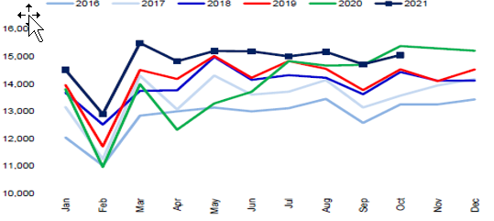
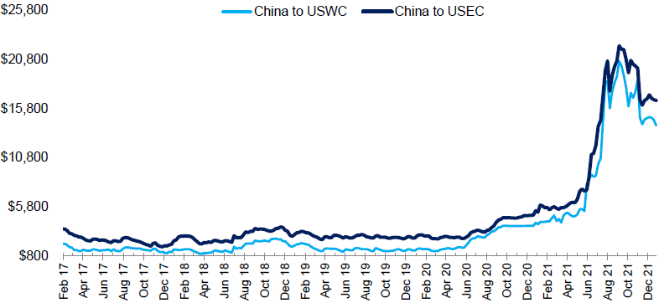
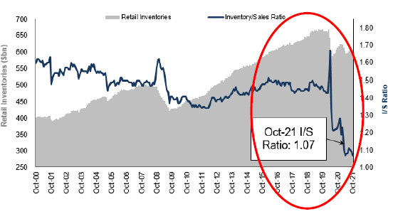
State of Global Logistics
Record Levels of Global Trade
Global Trade Volume - TEU
Global trade volume is currently at all-time records
Demand Driving Significant Rate Increases
China to U.S. Container Rates
Increased volume, capacity constraints, and shipping delays have resulted in significant cost increases to move inventory from China to the U.S.
Retail Inventories at Low Levels
Retail Inventories vs I/S Ratio
Retail inventory levels are low which many industry experts predict will result in a major restocking effort in H1 2022 putting more pressure on rates and capacity
Industry Experts predict recovery in the Ocean market beginning this summer023
Source: ContainerStatistics.com(left), Freightos Baltic Index (middle), U.S. Census Bureau(right), and Stifel research

Slide 8
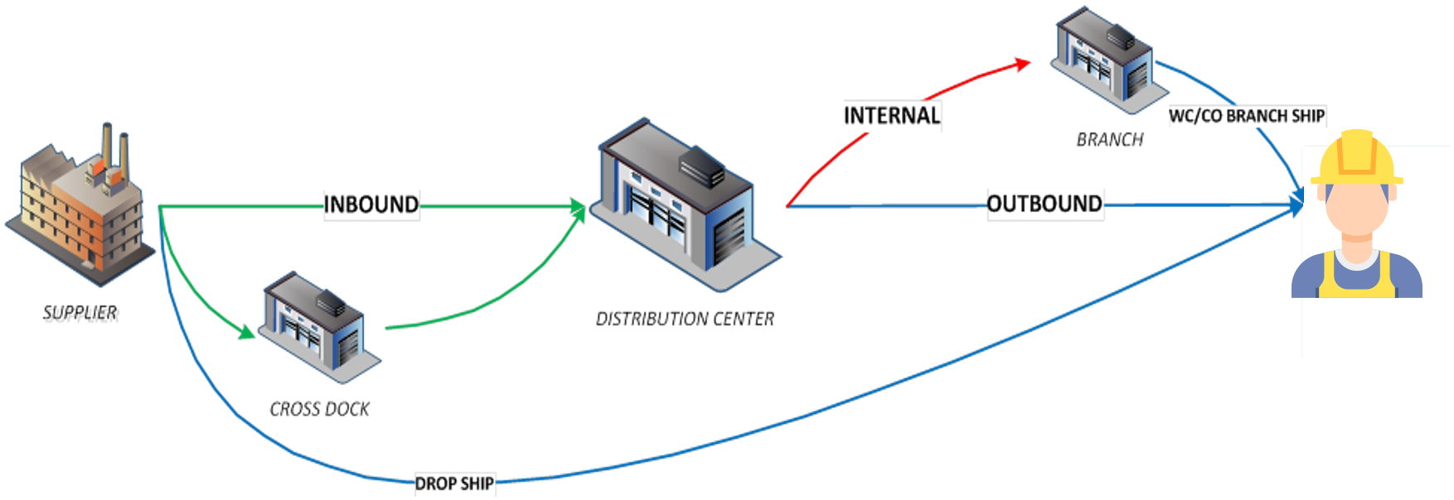
Supply Chain Disruptions Impact Service

Slide 9
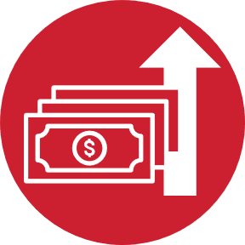
Actions we took to manage supply chain challenges
Bold Inventory Purchases
Recruitment Marketing
Wage Rate Increases
Service & Fulfillment
9

Slide 10
2022 Industry Outlook
Grainger’s Plan
Ocean cargo capacity remains tight
Workforce participation rates remain low
Wage rate and commodity inflation is high
Recover service to pre-pandemic levels
Invest in our future

