Slide 1
Supply Chain Ethics
American Axle & Manufacturing (AAM)
Faith A. Wandrie
Vice President- Global Supply Chain
February 15, 2019

Slide 2
Today’s AGENDA
American Axle & Manufacturing
AAM Supply Chain Framework and Scope
Supply Chain Ethics – Our Responsibilities
AAM Code of Business Conduct
Doing Business with AAM
SCM Ethics Matter

Slide 3
Company Overview
For over 20 years, vehicle manufacturers around the world have entrusted AAM to:
DESIGN | ENGINEER | MANUFACTURE
driveline, metal forming and casting systems for their vehicles.
Over that time, we’ve delivered innovative technologies and solutions that are:
SMARTER | LIGHTER | ELECTRIC
and even more EFFICIENT.
DELIVERING POWER
We’re in the business of Delivering POWER.

Slide 4
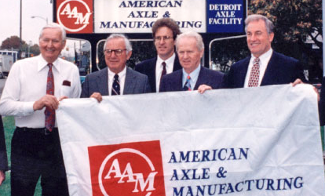
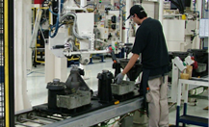
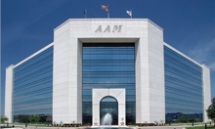
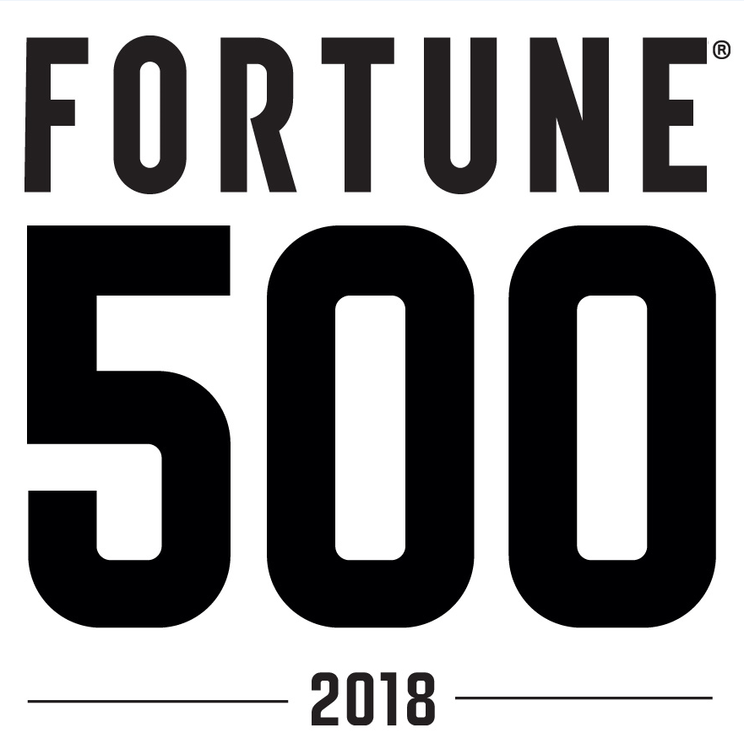
History Timeline
For over 20 years, AAM has been Delivering POWER
March 1, 1994
1994-1998
1999-2005
2006-2010
2011-2016
2017-Present
Acquired GM’s Final Drive and Forge Business Unit leading to the formation of AAM
Operational improvements and establishment of AAM culture
Capacity expansion and selective globalization
Restructure, Resize, Recover
Profitable global growth and diversification
Strategic actions enhance scale, product portfolio, and financial profile

Slide 5
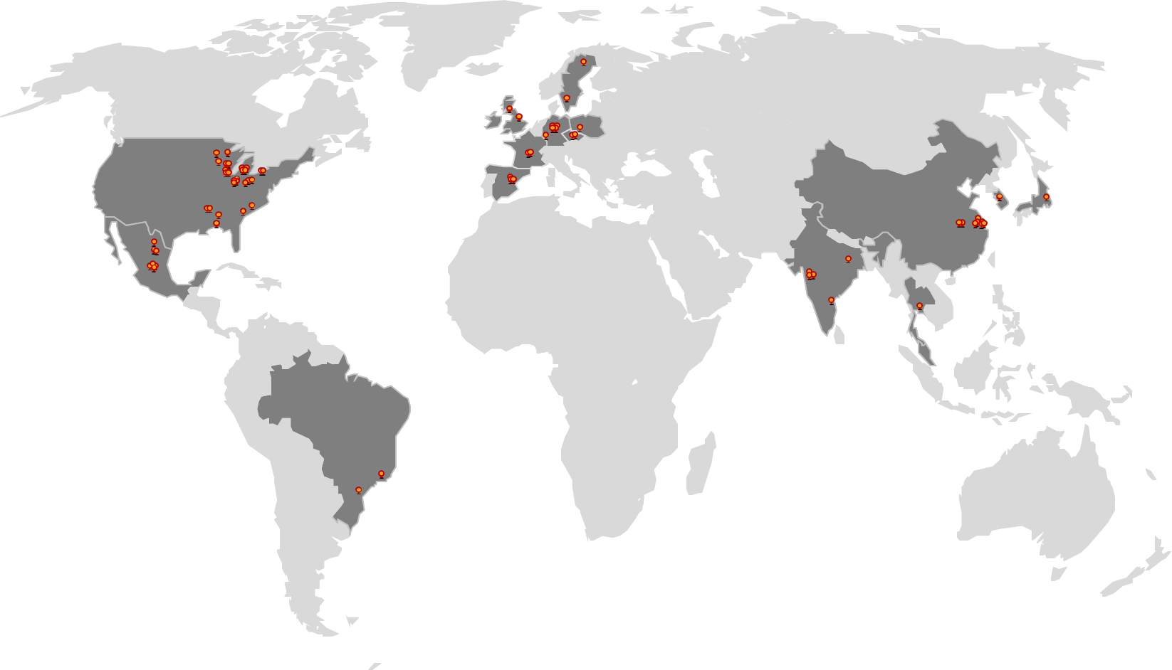
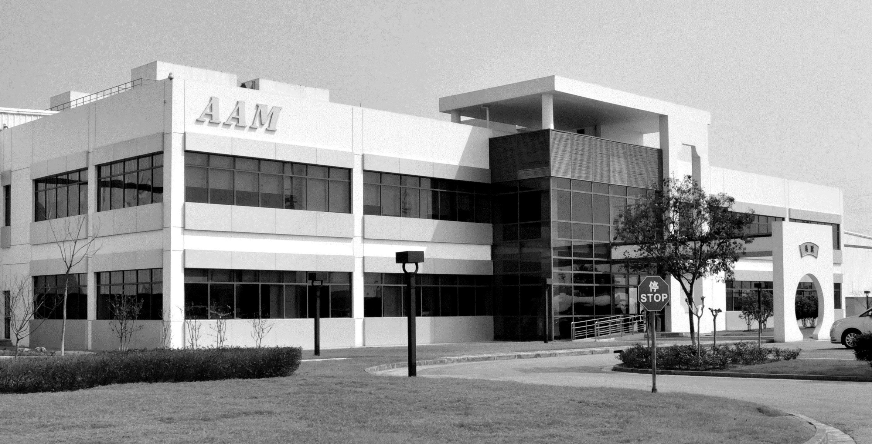
About AAM
Over
70
MANUFACTURING FACILITIES
≈$7.25B
2018 ESTIMATED SALES
Over
700
CUSTOMERS
16
ENGINEERING CENTERS
Over
25,000
ASSOCIATES
17
COUNTRIES
Over
85
LOCATIONS

Slide 6
Serving the World’s Leading Brands
CUSTOMERS WORLDWIDE
MORE THAN 700 CUSTOMERS WORLDWIDE

Slide 7
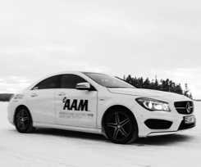
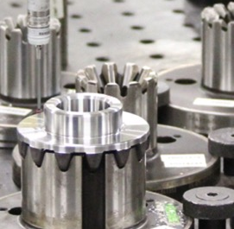
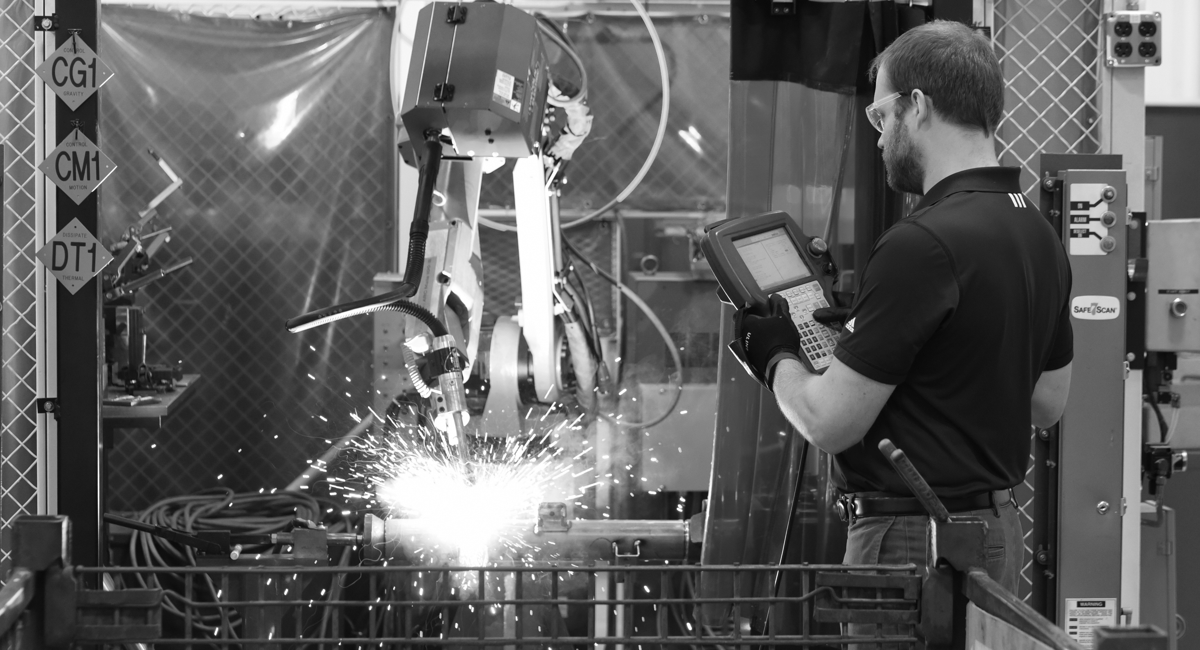
How We Deliver POWER
QUALITY
TECHNOLOGY LEADERSHIP
Innovative solutions that achieve requirements for safety, efficiency, performance, fuel economy and environmental friendliness.
OPERATIONAL EXCELLENCE
Global footprint that brings streamlining, standardization and synergies to exceed customer expectations.
World-class quality means operating with a commitment to achieving perfection.

Slide 8
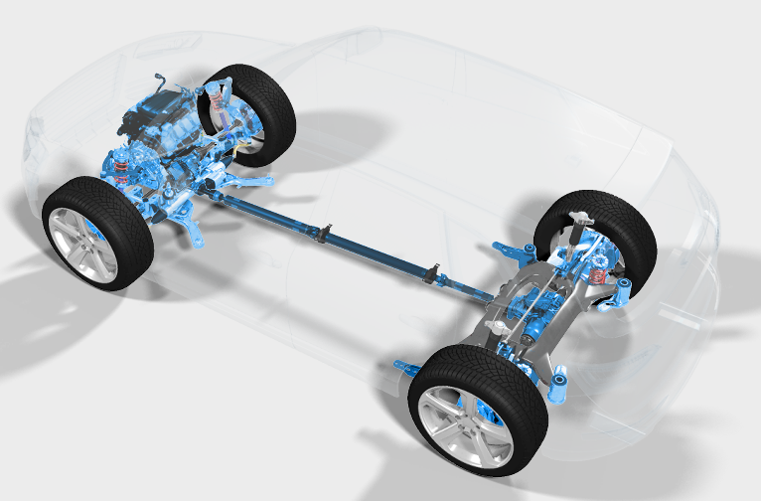
Diverse Product Portfolio 1
PRODUCT PORTFOLIO
COMPREHENSIVE SOLUTIONS
from engine to driveline
Aluminum valve bodies
Axle carriers
Axle / transmission shafts
Brackets
Connecting rods
Control arms
Driveshafts
Electric drive units
Differential gears, cases and assemblies
Power transfer units
Rear and front axles
Rear drive modules
Ring / pinion gears
Suspension components
Transfer cases
Transmission gears and modules
Turbo charger housings
Vibration control systems
VVT products

Slide 9
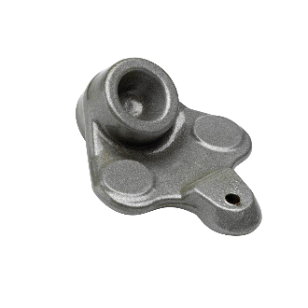
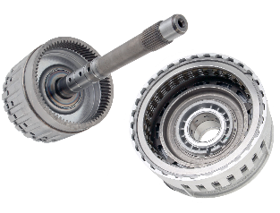
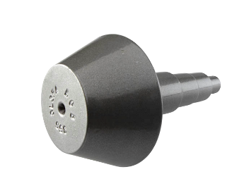
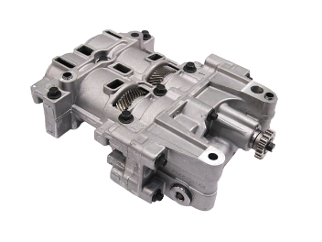
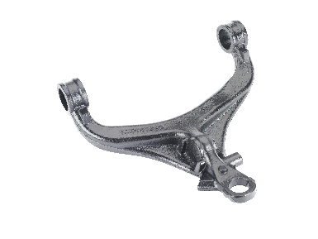
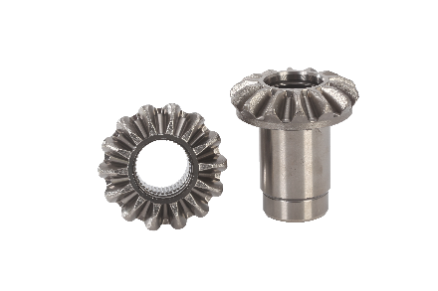
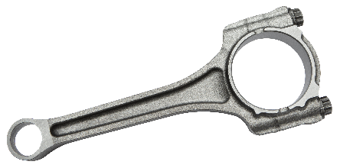
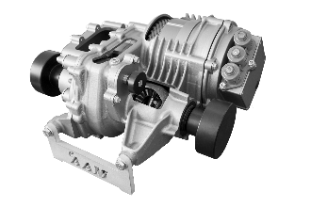
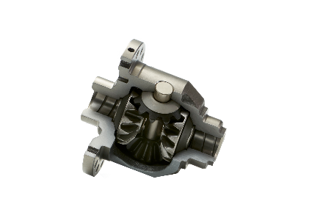
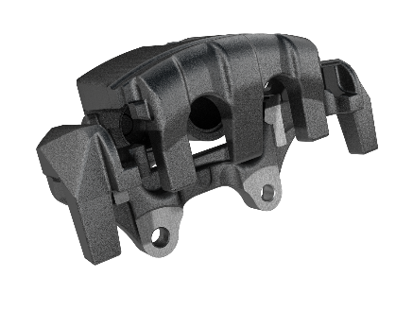
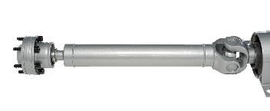
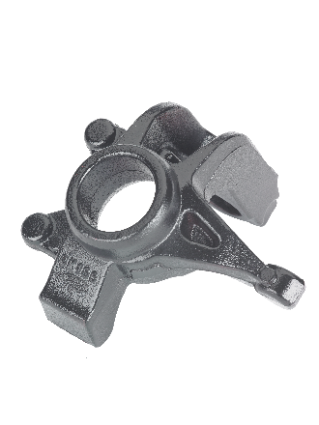
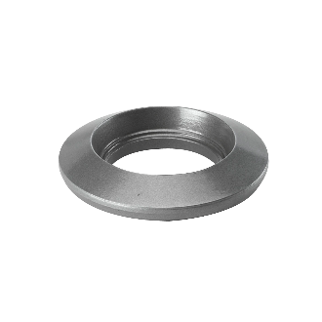
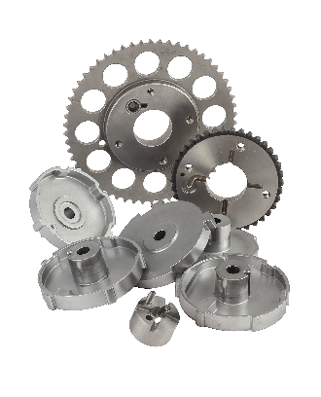
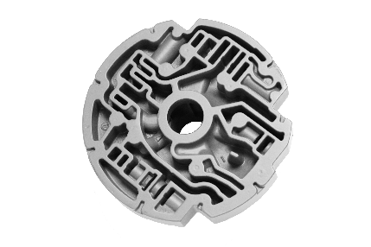
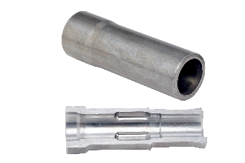
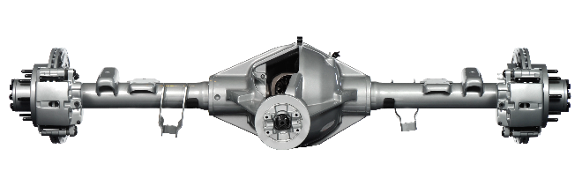
Diverse Product Portfolio 2
PRODUCT PORTFOLIO
DIVERSE & INNOVATIVE product portfolio that serves the global automotive market
DRIVELINE | ≈ $4.9B
METAL FORMING | ≈ $2.0B
CASTING | ≈ $900M
Balance shaft systems
Clutch modules
Driveshafts
Differential Assemblies
Electric drive units
Front & rear axles
Axle / transmission shafts
Connecting rods
Differential gears
Ring gears & pinions
Suspension components
Variable valve timing products
Axle carriers
Ball joint housings
Brake anchors & brake calipers
Control arms
Steering knuckles
Transmission pump bodies

Slide 10
AAM Supply Chain Framework and Scope

Slide 11
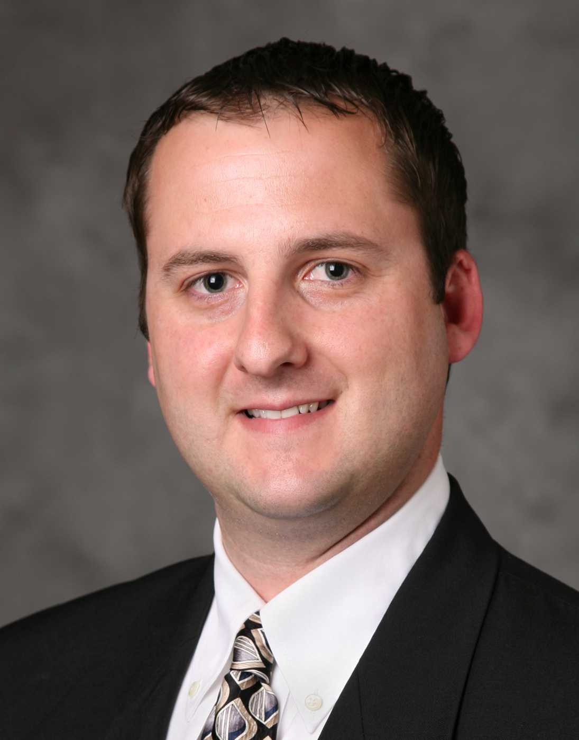
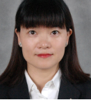
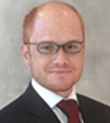
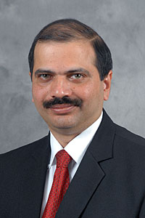
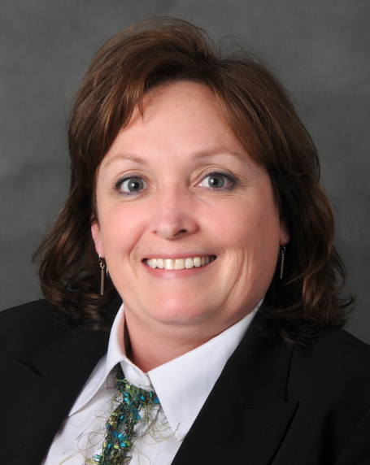
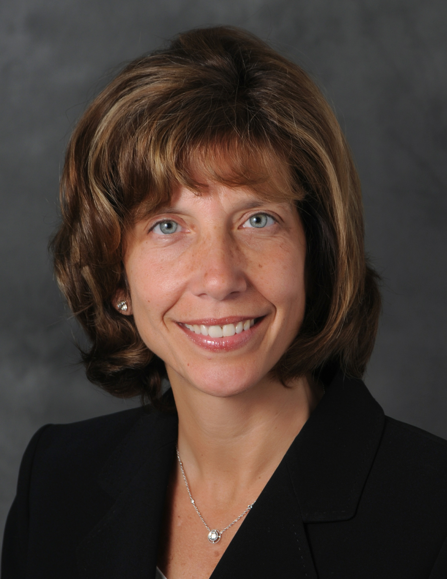
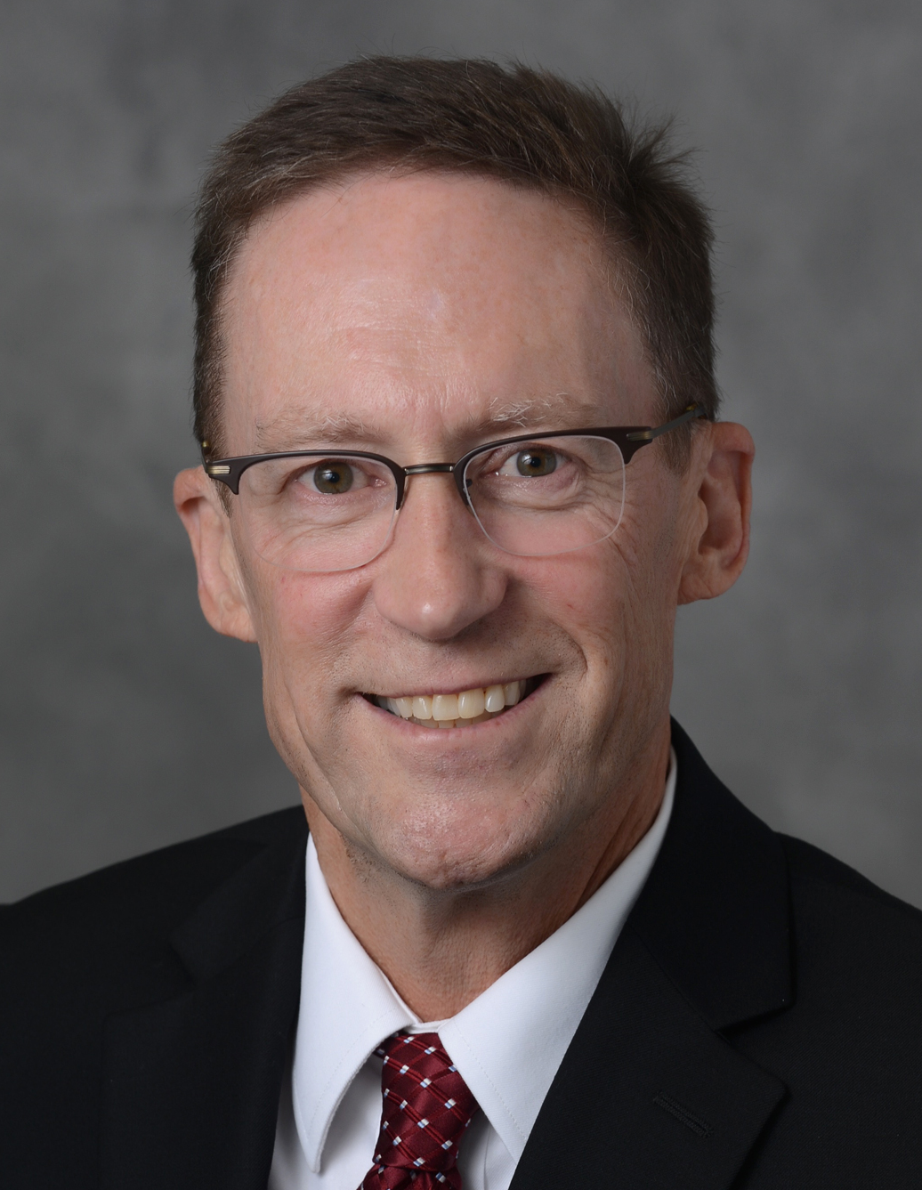
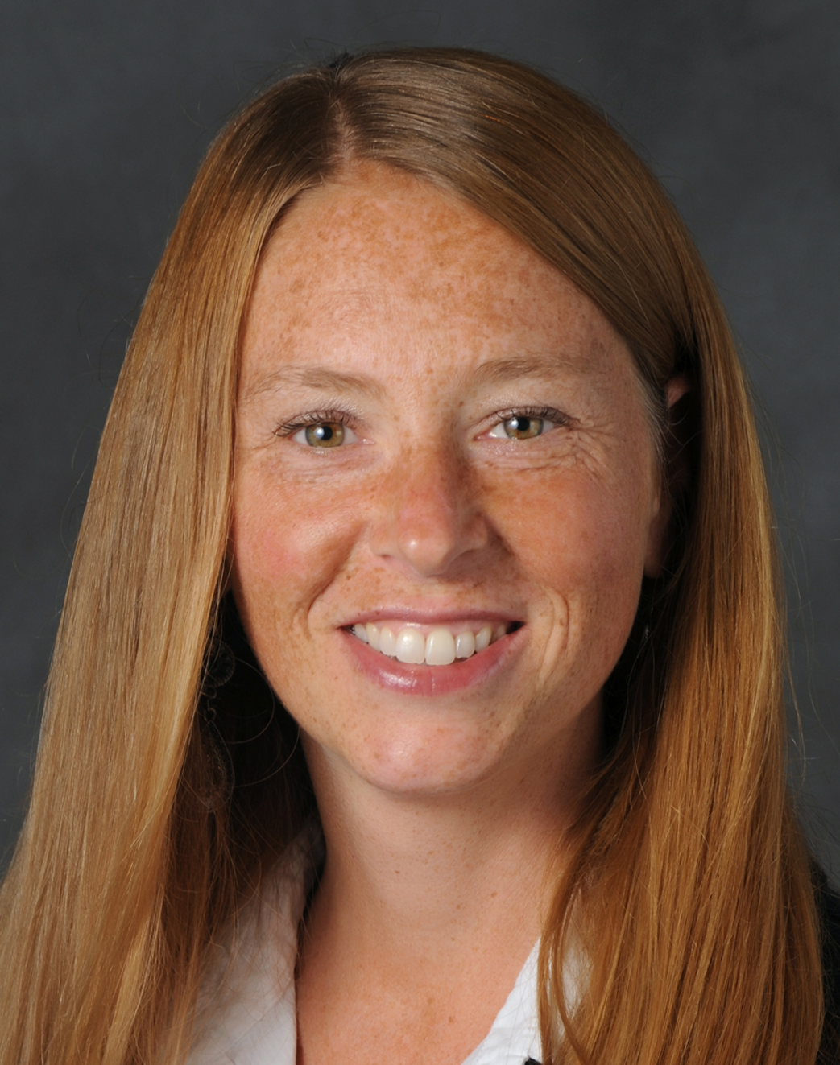
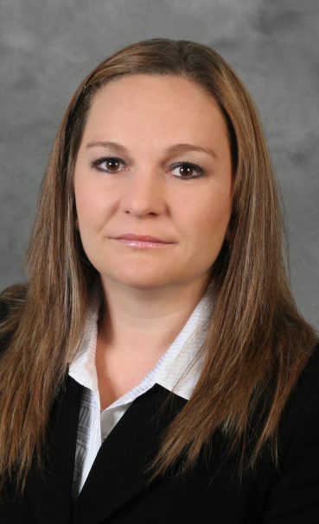
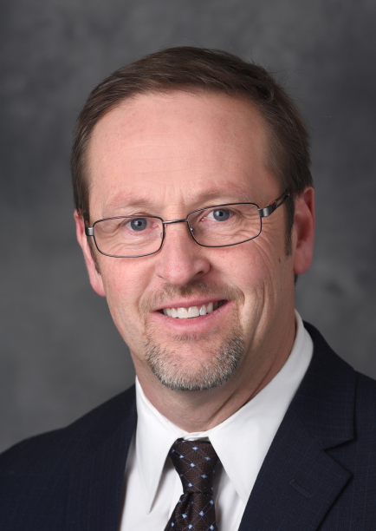
Global Supply Chain Organization
PRODUCT PORTFOLIO
Americas
Europe
Asia
Mexico
India
REGIONAL
Phil
Ross
Open
Alicia
Xu
Rodrigo
Miro
Chaitanya
Apte
SC Operations
SC Systems
Logistics
Trade Compliance
BUSINESS UNIT
Faith A. Wandrie
Vice President, Global SCM
CORPORATE
Eddie
Hobson
Terri
Missant
Ray
Hatfield
Kristen
Gibson
Ana Lucia Ochoa
Robert McCormick

Slide 12
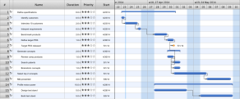
Supply Chain Breadth
Advanced Materials
Launch Management and Change Management
Logistics & Customs
Rate Management and Optimization
Supplier Management
Materials Planning and Scheduling
Material Handling
Physical Movement
Customer Attainment
Production Planning and Scheduling
DATA INTEGRITY
COMMUNICATION
COST
RISK
ROBUSTNESS
CUSTOMER
Project Management
New Programs
Engineering changes
Big Layout Changes
Systems
Implementations
Constant Network Redesign
Cost optimization
InTransit Inventory
Duty Management
PFES
Risk Management
PFEP & INV Stabilization
Supplier Evaluation
Purchasing Interface
Total Inventory Ownership
Customs Compliance
Storage and Flow
Strategy
Logistics Engineering
Assets Utilization
OCD Mindset
Capacity Analysis
16w Owners
VSM Owners
Plant Scheduling
Real Time Communicators!
KPIs
KPIs
KPIs
KPIs
KPIs
Gate Reviews on time
Launch Readiness
Business Case Attainment
Zero Obsolescence
Lead Time Attainment
Premium Freight
Customs Liability
Cube & Volume Metrics
PFEP Attainment
Turns
Line Disruptions
E&O
Supplier Rating
PIP & Market Basket MGMT
Safety
Inventory Accuracy
Line Disruptions
Cycle Count Attainment
Customer Ratings
Customer Complaints
FG&WIP INV Levels
Build Attainment by mix
Ship Attainment
Past Due Management
AAM Operating System - MMOG Alignment – Contingency Planning

Slide 13
AAM Vision and Mission
VISION
To POWER the future and provide value to our stakeholders.
PERFORMANCE
MISSION
To deliver efficient, powerful and innovative solutions for our customers while leading the industry in quality, operational excellence and technology to maximize shareholder value.
To POWER the future and provide value to our stakeholders.
SCM Vision:
To be the leader in disciplined lean Supply Chain techniques and execution, by a highly skilled global workforce, delivering value and providing a competitive advantage.
SCM Mission:
To exceed expectations globally through agility, adaptability and alignment driven by a disciplined and well executed supply chain strategy.
13

Slide 14
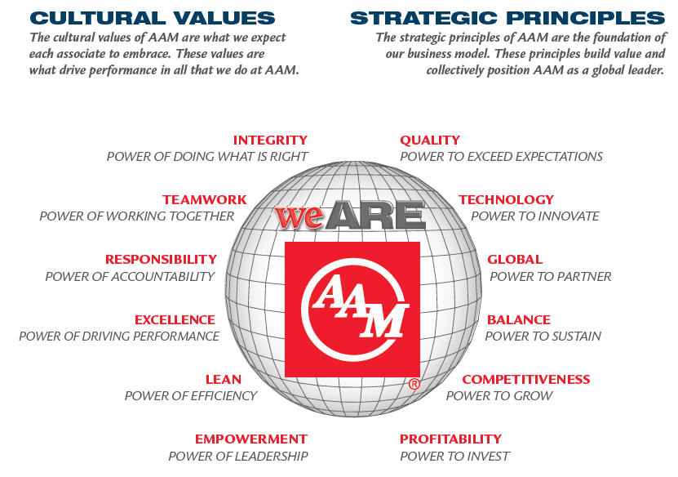
This is what AAM stands for, what we believe.

Slide 15
Supply Chain Ethics – Our Responsibilities

Slide 16
Corporate Responsibility
Ownership at AAM starts with each and every one of us!
AAM operates an ethical supply chain with the support teams, as it is everyone’s responsibility:
Human Resources
Procurement
Supply Chain
Security
Internal Audit
Supplier Development (SQEs)
Our plants, our associates, our customers, our suppliers and our OSPs

Slide 17
Human Resource Responsibility
Eliminating discrimination in the workplace
Labor conditions
Supporting and protecting human rights
Eliminating child and human labor
Protecting our records
Integrity in all relations
Fair treatment

Slide 18
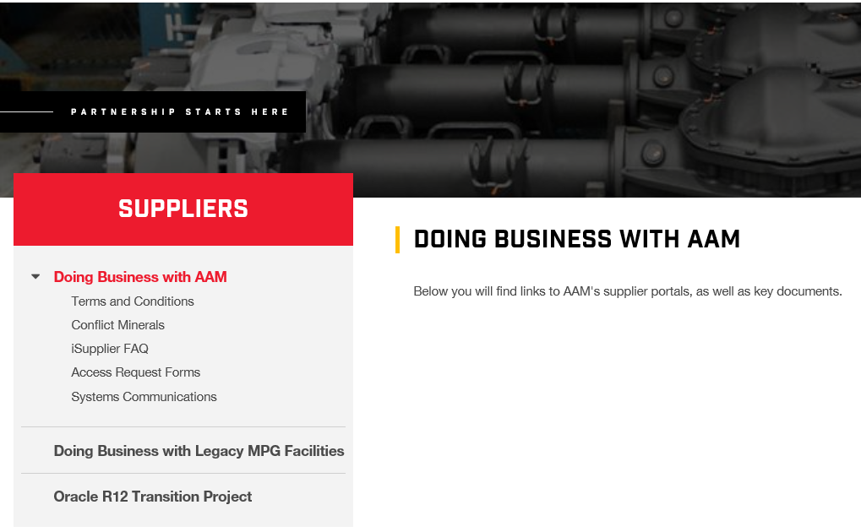
Procurement Responsibility
Supplier labor conditions
Fighting supplier corruption
Ethical sourcing
Avoiding human rights abuses in all tiers
Supporting and protecting human rights
Eliminating child and forced labor across the supply chain
Avoiding use of conflict materials
Formal code of conduct for suppliers

Slide 19
SCM Responsibility
Uphold Environmental Responsibility
Focus on our Carbon Footprint
Development of a Returnable Container Policy
Re-use of expendable packaging (cardboard and pallets)
Recycling
AAM strives to reduce Green House Gas (GHG) generation, water consumption and use of landfills for waste disposal.
AAM initiated energy saving programs, waste reduction programs and has initiated water resource reviews in all of its facilities.

Slide 20
Importance
Extremely important to AAM – continuity of supply is critical due to our low operating inventory levels.
Our customer’s customers play a much bigger role today, demanding socially, ethically and environmentally conscience products–- they expect it!
Must be sustainable- we cannot put ourselves in a position that supply chain ethics could create a diversion beyond our contingency planning.
Supply Chain visibility and transparency is critical to our team.
Our agile and flexible framework is very important to our customers.

Slide 21
AAM Code of Business Conduct

Slide 22
Code of Business Conduct
The AAM Code of Business conduct (the ‘Code’) provides a framework for decision making and conduct in key areas.
It applies to all associates and agents of AAM…
Our production suppliers, our indirect suppliers, our outside service suppliers (OSPs), our contractors and our temporary labor services.
Everyone who does business with AAM!
Everyone is encouraged to raise concerns.
The business ethics line is available to all associates and business partners, non-AAM personnel who are available 24 hours a day, seven days a week.

Slide 23
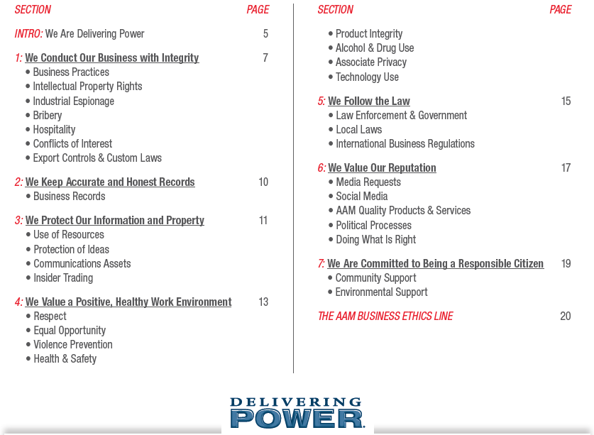
AAM’s Code of Business Conduct

Slide 24
We conduct our business with integrity! 1
AAM’s suppliers are essential partners in our success.
Suppliers must be honest and fair.
We select based on the basis of quality, technical excellence, price, delivery and service.
We expect our suppliers to comply with the laws and AAM standards relating to labor environment, health and safety, intellectual property rights, anti-corruption and other matters.
We consider the Code of Business Conduct and the Supplier Requirements in all sourcing process and expect suppliers to adhere to the requirements of both.

Slide 25
We conduct our business with integrity! 2
We prevent bribery.
Suppliers, agents and consultants hired to act on AAM’s behalf are prohibited from directly or indirectly receiving or offering any form of bribe, kickback or corrupt payment, to or from AAM associates, public officials or anyone- with the intention to obtain or retain business or any other improper advantage.
We avoid conflicts of interest.
We comply with all applicable laws wherever AAM does business.
We comply with export controls and customs laws.

Slide 26
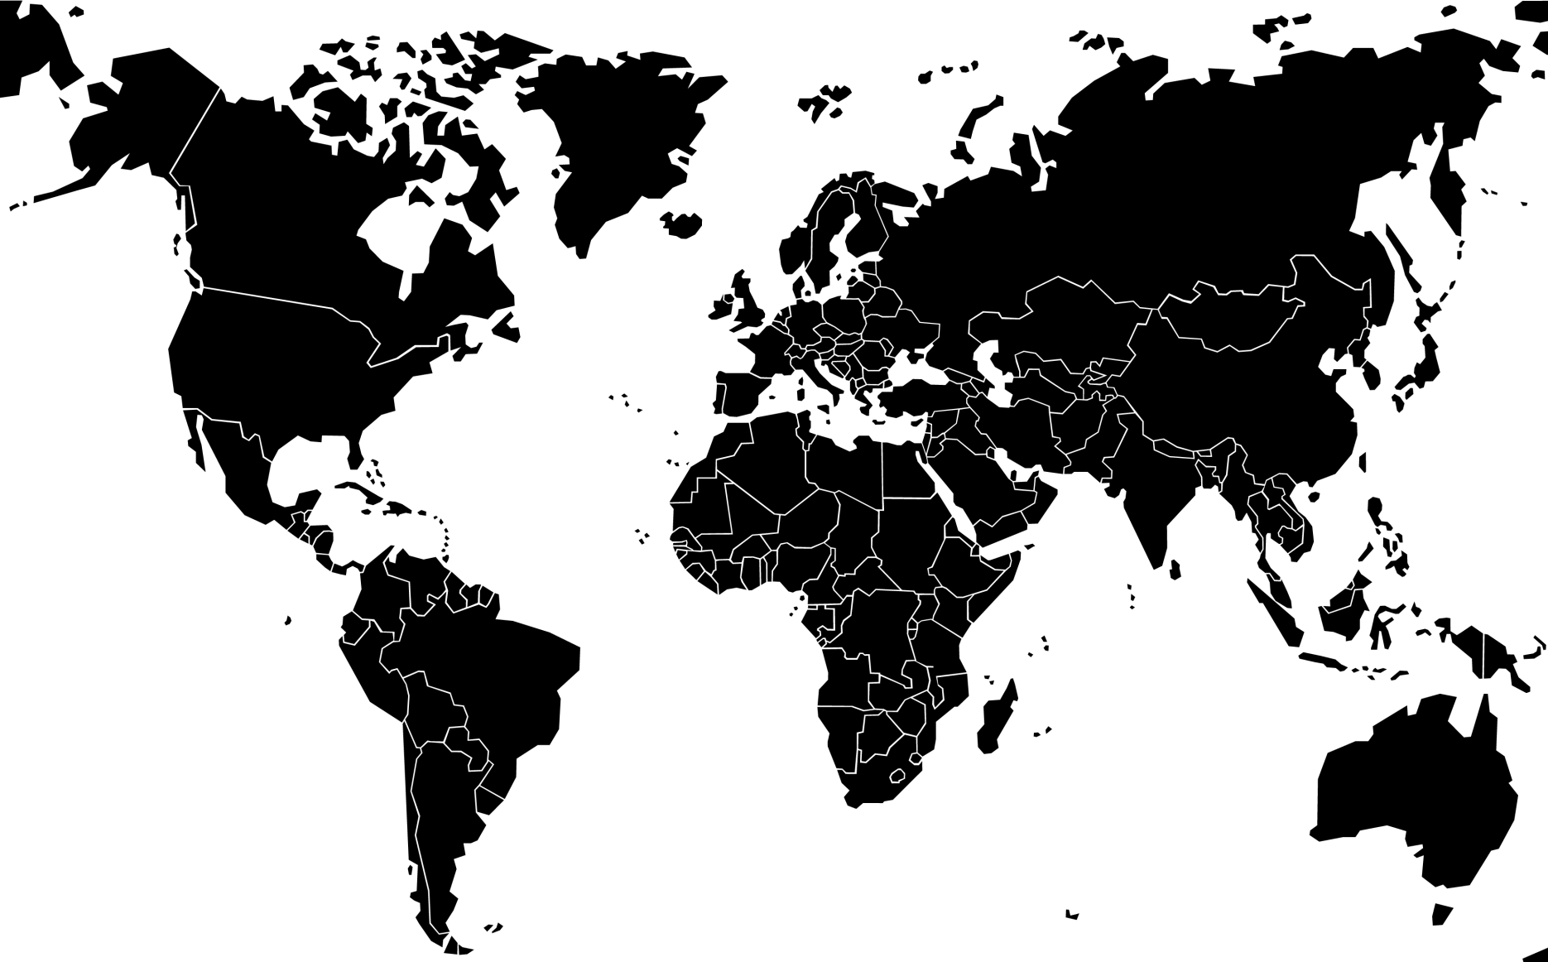
Customs Preferential Programs & Trade Agreements
EUROPEAN UNION – Avg. Rate: 3.5%
GSP (IN)
EU-TURKEY (TR)
EU-MEX FTA (MX)
EU-KOR FTA (KR)
USA – Avg. Rate: 2.5%
GSP (TH, BR, IN, TH)
NAFTA (MX-CA)
KORUS FTA (KR)
U.S. GOODS RETURNED (Worldwide)
CHINA – Avg. Rate: 10%
APTA (IN, KR)
ASEAN (TH)
DRAWBACK
8,000 NA parts Qualified under FTAs
MEXICO – Avg. Rate: 5%
NAFTA (US, CA) no DTA into MX
PROSEC (CN, IND, TH, KR, TW, JP) [Sectorial Promotion Program]
RULE 8 (CN, IND, KR, TH, JP) [HTS Specific & Quota Limit]
EU-MEX FTA (EU)
ALADI - ACE No. 55 (BR)
THAILAND – Avg. Rate: 30%
FREE TRADE ZONE (Worldwide)
INDIA – Avg. Rate: 10%
EPCG (Worldwide) [Export Promotion Capital Goods]
BRAZIL Avg. Rate: 18%
ALADI – ACE 55 (MX)
DRAWBACK
NOTE: Avg. General Duty Rate reflects the general duty rate applicable, to most common AAM automotive products, without any preferential duty trade program or free trade agreement in effect.

Slide 27
We conduct our business with integrity! 3
We comply with international business regulations.
Proper business practices within Maquiladora (Annex 24 and Annex 31)
Effective foreign trade zone management, etc.
We keep accurate and honest records – each plant has an associate or a team assigned to Data Integrity, within SCM.
We use our resources responsibly.
We value and protect our ideas.
We respect each other.
We prevent violence.

Slide 28
We conduct our business with integrity! 4
We promote health and safety
This year’s SCM safety focus is on Safety Non-Negotiables
Every SCM safety near-miss or lost time event requires a read-across, across the globe within three business days.
We value product integrity
We do not tolerate possession or use of alcohol, illegal drugs or controlled substances.
Each plant that has product crossing borders is required to use our trailer seal best practice, which includes serial seal management.

Slide 29
We conduct our business with integrity! 5
We do what is right!
Maintaining our reputation as an ethical organization requires more than simply doing the minimum that is required by law. It means doing what we know is right, even if those situations are not covered by specific regulations or policies.

Slide 30
Doing Business with AAM

Slide 31
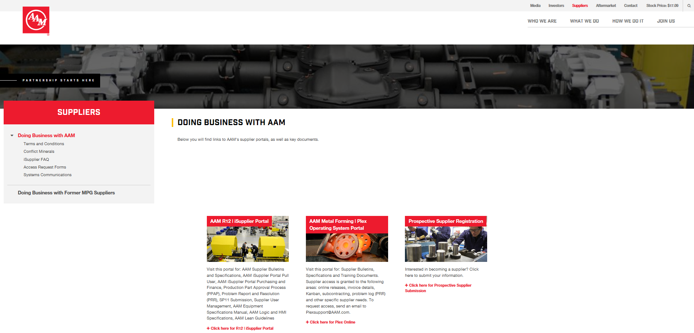
Doing Business with AAM 1

Slide 32
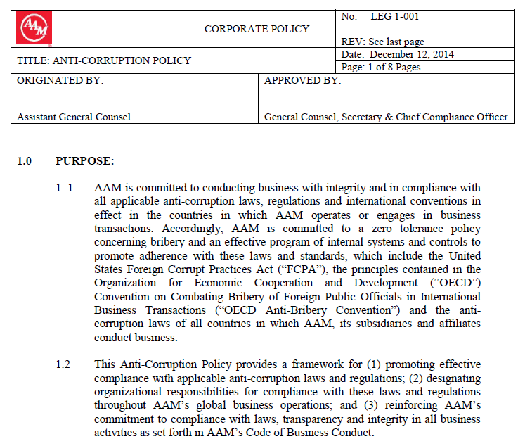
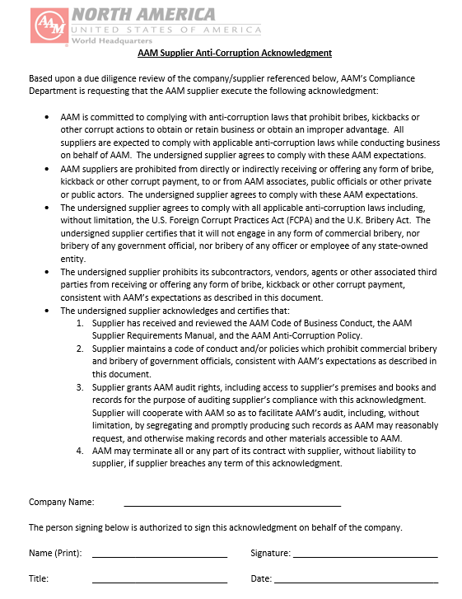
AAM Anti-Corruption Policy
Supplier Acknowledgement Required

Slide 33
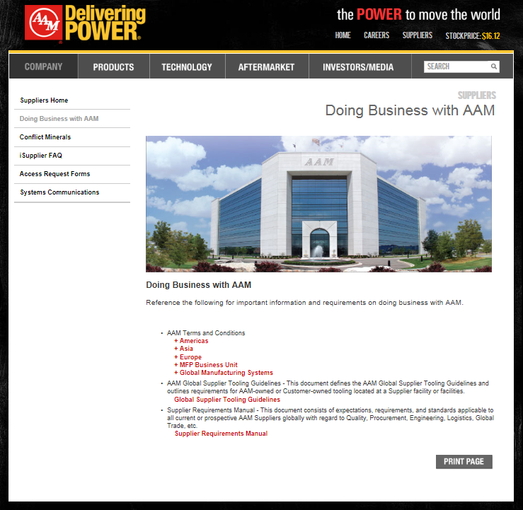
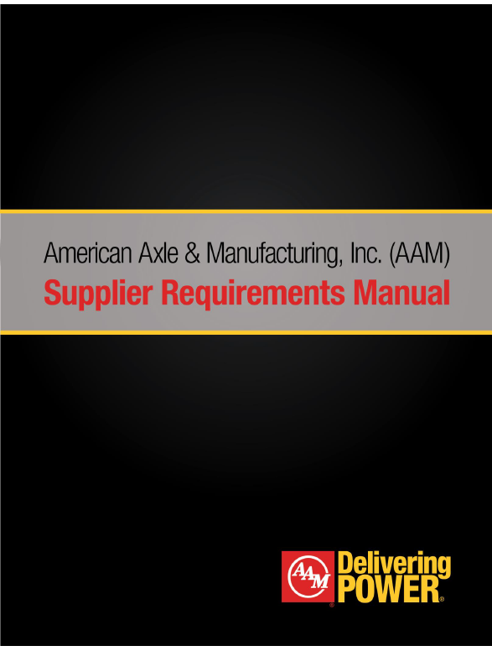
Supplier Requirements Manual
1.4 Code of Business Conduct
specifically relates to our suppliers
1.9 Social Responsibility
The Environment
Conduct and Ethics
Bribery & Corruption
Business Records
Conflict of Interest
Fair Business Practices
Labor
Sustainability
Diversity Sourcing
Conflict Materials
Raising Concerns
www.aam.com

Slide 34
Supply Chain Sustainability
Suppliers are strongly encouraged to take an active role in AAM’s sustainability mission by completing the following offered by AIAG:
Supply Chain Sustainability Knowledge Assessment
Supply Chain e-Learning Course
AAM has participated in the Carbon Disclosure Project since its inception.
Taking voluntary actions down our tiers to reduce environmental impacts including GHGs are use of toxic material is vital.

Slide 35
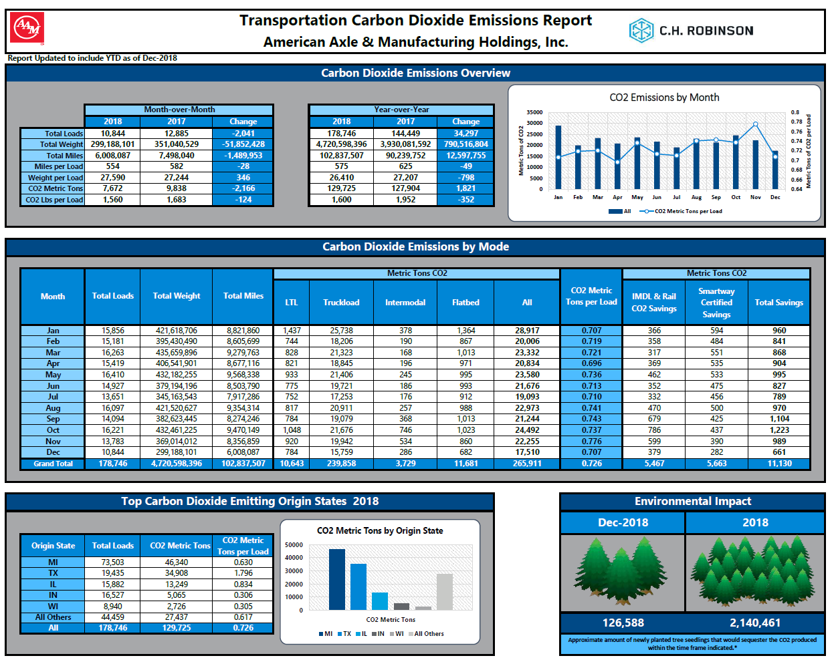
Carbon Footprint

Slide 36
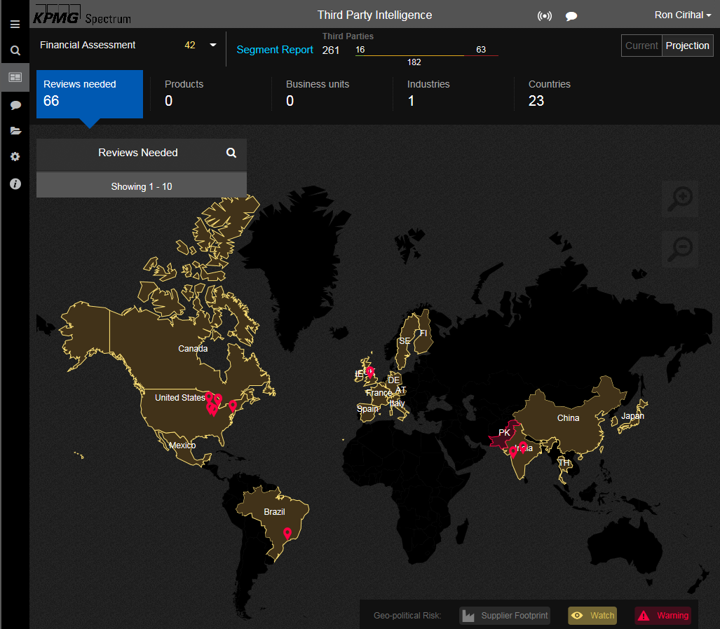
Third Party Intelligence

Slide 37
SCM Ethics Matter

Slide 38
Responsible and Ethical Supply Chain
We are AAM
We treat the ethical supply chain seriously.
We take proactive steps to avoid reputation damage.
We encourage our SCM teams to be transparent.
We make problems visible.
We take responsibility for the environment.
We owe it to our associates to leave work every day the same way they walked in door each day!

Slide 39
Thank you for your time … Q&A!

